Slide 1
Introduction to Python
The University of Iowa
Tianbao Yang
tianbao-yang@uiowa.edu

Slide 2
A Python programming class for you
CS:5110, Introduction to Informatics
Will Cover:
Python programming
Algorithmic/Computational thinking
Little machine learning

Slide 3
Requirements
Homework assignments (one week or so): 45%
mostly programming
enrolled students
auditing students (60%+) homework assignments
Exams: 50%
Mid-term (in-class): 20%
Final (in-class): 30%
enrolled students
Participation: 5%
enrolled students and auditing students

Slide 4
Prerequisites
High school algebra and
A reasonable aptitude for mathematics

Slide 5
Course Content
Part 0: Getting Started
Part 1: Components of Python (Ch. 1-8)
variable, functions, lists, debugging, class
Part 2: Algorithmic thinking (Ch. 9 – 16)
computational complexity, simple algorithms
Part 3: Slightly Advanced topics (Ch. 17 – 19)
optimization, dynamic programing
simple methods in Machine Learning

Slide 6
Programming Languages

Slide 7
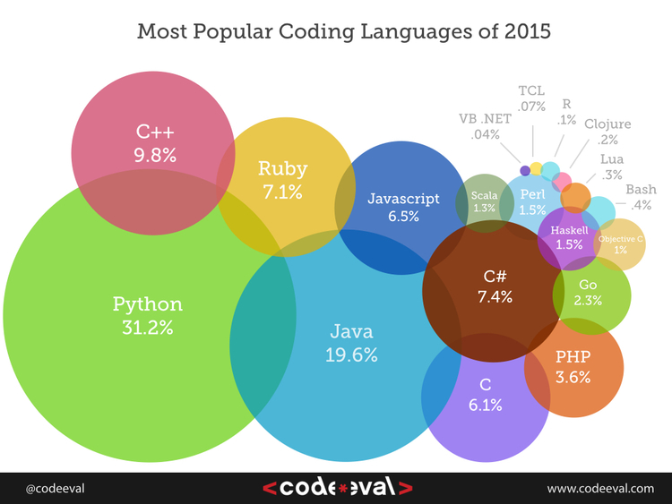
Programming Languages

Slide 8
Programming Languages
Goal:
provide a way to describe algorithmic steps
defines a set of primitives
allows us to create new primitives
programming languages defines syntax and semantics needed to translate computational ideas into mechanical steps

Slide 9
Programming Language is like Natural Language
1. Primitive Constructs
Python: literals (number 3.2, string ‘abc’)
English: words
2. a syntax
defines which strings of characters and symbols are well formed
English: “Cat Dog Boy” Not syntactically valid
Python: 3.2+3.2 OK, 3.2 3.2 Not OK
3. a static semantics
defines which syntactically valid strings have a meaning

Slide 10
Programming Language is like Natural Language
3. a static semantics
defines which syntactically valid strings have a meaning
English: “I are big” Syntactically OK, but not valid
Python: 3.2/’abc’ static semantic error

Slide 11
Programming Language is also different
semantics
associates a meaning with each syntactically correct string of symbols that has no static semantic errors
English: semantics of a sentence can be ambiguous
e.g., “I cannot praise this student too highly
Programming: each legal program has exactly one meaning

Slide 12
Error Detection of a Programming Language
syntactic error
every serious programming language does detect syntactic errors
static semantic error
some languages do a lot of static semantic checking (Java)
Python does some checking while running the program
It does not catch all static semantic errors before running program

Slide 13
What might happen when the program has an error?
Crash (stop running and produce some sort of obvious indication that it has done so)
Keep running, running and running and never stop
It might complete and produce an answer that might or might not be correct

Slide 14
Options of Programming Languages
Source Code
Checker
Interpreter
Output
Compiler
Object Code

Slide 15
Options of Programming Languages
Source Code
Checker
Interpreter
Output
Low level Programming Languages uses similar constructions to internal control unit
Move data from one location to another
Execute a simple ALU operation
Jump to new point in instruction sequences
Checker confirms syntax, static semantics correct
Interpreter just follows sequence of simple instructions

Slide 16
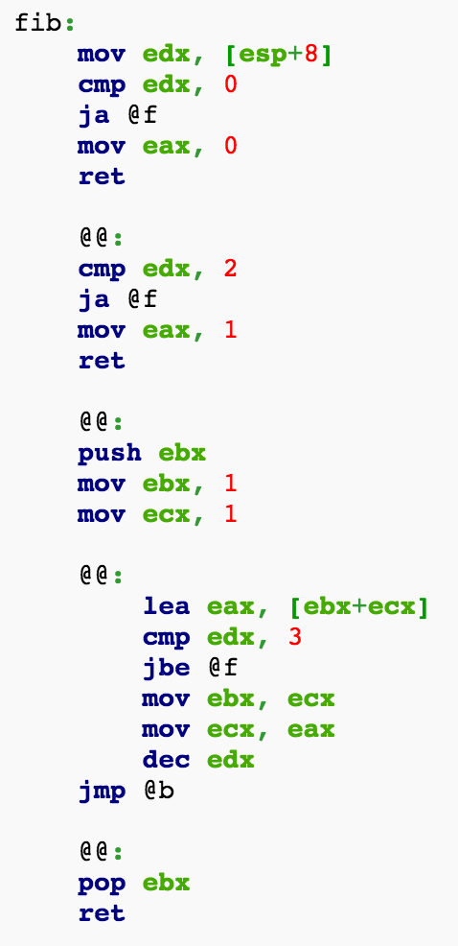
Options of Programming Languages
Source Code
Checker
Interpreter
Output
Assembly Language

Slide 17
Options of Programming Languages
Source Code
Checker
Interpreter
Output
High level
Compiler
Object Code
low level
High level Programming Languages: Complied language
Compiler converts abstractions into low level instructions
Called Complied Language
E.g., C, C++

Slide 18
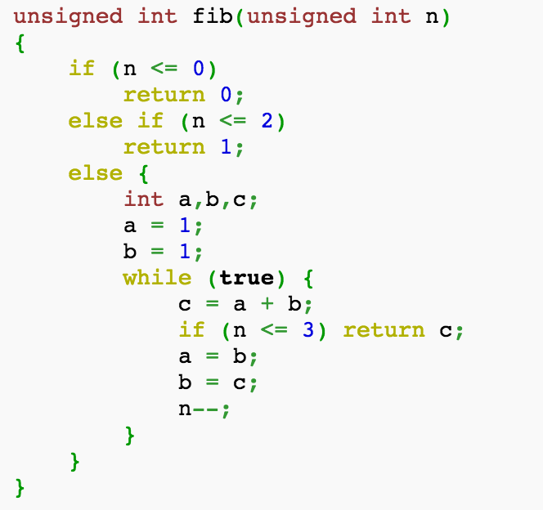
Options of Programming Languages
Source Code
Checker
Interpreter
Output
High level
Compiler
Object Code
low level
C/C++

Slide 19
Options of Programming Languages
Source Code
Checker
Interpreter
Output
High level
low level
High level Programming Language: Interpreted Language
Special program converts source code into internal data structure
Interpreter sequentially converts each step into low level instructions and executes them
E.g., Python

Slide 20
Options of Programming Languages
Source Code
Checker
Interpreter
Output
Compiler
Object Code
Low level languages: hard to read
High level languages:
compiled : difficult to debug, run quickly, use less space
interpreted: easy to debug, run less efficient

Slide 21
Python Program
Program (or script) is a sequence of definitions and commands
Can be typed directly into a shell
Stored in a file (can be executed)

Slide 22
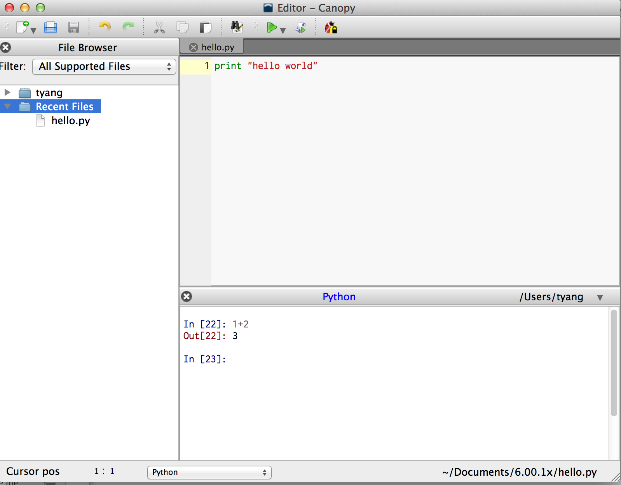
Python Program
Program (or script) is a sequence of definitions and commands
Can be typed directly into a shell
Canopy

Slide 23
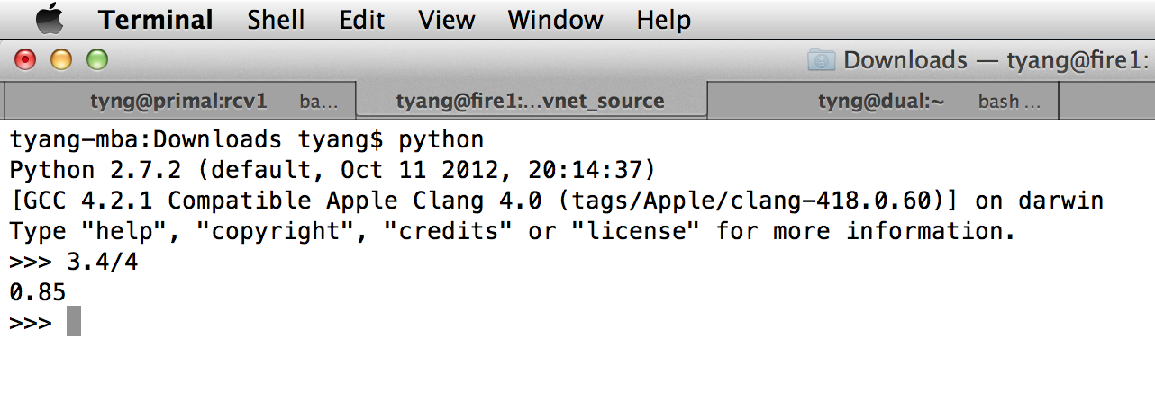
Python Program
Program (or script) is a sequence of definitions and commands
Can be typed directly into a shell
Terminal

Slide 24
Python Program
Program (or script) is a sequence of definitions and commands
Can be stored into a file

Slide 25
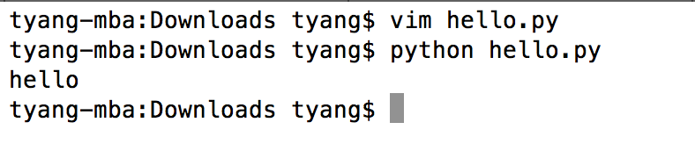
Python Program
Program (or script) is a sequence of definitions and commands
Can be stored into a file

Slide 26
Introduction to Python
Basic Elements of Python
Branching Programs
Iteration

Slide 27
The Basic Elements of Python
Objects
Expressions
Variables

Slide 28
Objects
Core things that python programs manipulate
Every object has a type
Type defines the kinds of things that programs can do with the object of that type

Slide 29
Objects
Scalar Type
Scalar objects are indivisible
Integer (int), e.g. 1, 2, 3, 4
Float (represent real numbers), e.g., 3.2, -29, 1.6E3
Boolean (bool): True or False
None: single value
Non-scalar Type
String, list, dict, …

Slide 30
Expressions
Expressions: Objects and Operators combined
Operators: +, -, *, /, %, >, <, ==, !=, >=, <=

Slide 31
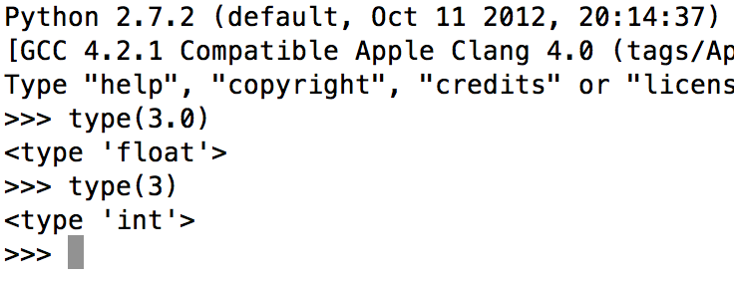
Algebraic expressions
>>> 2 + 3
5
>>> 7 - 5
2
>>> 2*(3+1)
8
>>> 5/2
2.5
>>> 5//2
2
>>> 5.0/2
2.5
>>> 14%3
2
>>> 2**3
8
>>> abs(-3.2)
3.2
>>> min(23,41,15,24)
15
>>> max(23,41,15,24)
41
>>> 2 + 3
5
>>> 7 - 5
2
>>> 2*(3+1)
8
>>> 5/2
2.5
>>> 5//2
2
>>> 5.0/2
2.5
>>> 14%3
2
>>> 2**3
8
>>> abs(-3.2)
3.2
>>> 2 + 3
5
>>> 7 - 5
2
>>> 2*(3+1)
8
>>> 5/2
2.5
>>> 5//2
2
>>> 2 + 3
5
>>> 7 - 5
2
>>> 2*(3+1)
8
>>> 2 + 3
5
>>> 2 + 3
5
>>> 7 - 5
2
>>> 2*(3+1)
8
>>> 5/2
2.5
>>> 5//2
2
>>> 5.0/2
2.5
>>> 14%3
2
>>> 2**3
8
>>> 2 + 3
5
>>> 7 - 5
2
>>> 2*(3+1)
8
>>> 5/2
2.5
>>> 5//2
2
>>> 5.0/2
2.5
>>> 14%3
2
>>> 2 + 3
5
>>> 7 - 5
2
>>> 2*(3+1)
8
>>> 5/2
2.5
>>> 5//2
2
>>> 5.0/2
2.5
>>> 14%3
2
>>> 2**3
8
>>> abs(-3.2)
3.2
>>> min(23,41,15,24)
15
>>> 2 + 3
5
>>> 7 - 5
2
>>> 2*(3+1)
8
>>> 5/2
2.5
>>> 2 + 3
5
>>> 7 - 5
2
The Python interactive shell can be used
to evaluate algebraic expressions
14//3 is the quotient when 14 is divided by 3 and 14%3 is the remainder
Python 3.0
2**3 is 2 to the 3rd power

Slide 32
Boolean expressions
In addition to algebraic expressions,
Python can evaluate Boolean expressions
Boolean expressions evaluate to
True or False
Boolean expressions often involve comparison operators
<, >, ==, !=, <=, and >=
>>> 2 < 3
True
>>> 2 > 3
False
>>> 2 == 3
False
>>> 2 != 3
True
>>> 2 <= 3
True
>>> 2 >= 3
False
>>> 2+4 == 2*(9/3)
True
In an expression containing algebraic and comparison operators:
Algebraic operators are evaluated first
Comparison operators are evaluated next

Slide 33
Boolean operators
>>> 2<3 and 3<4
True
>>> 4==5 and 3<4
False
>>> False and True
False
>>> True and True
True
>>> 4==5 or 3<4
True
>>> False or True
True
>>> False or False
False
>>> not(3<4)
False
>>> not(True)
False
>>> not(False)
True
>>> not True
False
>>> 4+1==5 or 4-1<4
True
In addition to algebraic expressions,
Python can evaluate Boolean expressions
Boolean expressions evaluate to True or False
Boolean expressions may include Boolean operators and, or, and not
In an expression containing algebraic, comparison, and Boolean operators:
Algebraic operators are evaluated first
Comparison operators are evaluated next
Boolean operators are evaluated last

Slide 34
Exercise
Translate the following into Python algebraic or Boolean expressions and then evaluate them:
The difference between Annie’s age (25) and Ellie’s (21)
The total of $14.99, $27.95, and $19.83
The area of a rectangle of length 20 and width 15
2 to the 10th power
The minimum of 3, 1, 8, -2, 5, -3, and 0
3 equals 4-2?
The value of 17//5 is 3?
The value of 17%5 is 3?
284 is even?
284 is even and 284 is divisible by 3?
284 is even or 284 is divisible by 3?
>>> 25 - 21
4
>>> 14.99 + 27.95 + 19.83
62.769999999999996
>>> 20*15
300
>>> 2**10
1024
>>> min(3, 1, 8, -2, 5, -3, 0)
-3
>>> 3 == 4-2
False
>>> 17//5 == 3
True
>>> 17%5 == 3
False
>>> 284%2 == 0
True
>>> 284%2 == 0 and 284%3 == 0
False
>>> 284%2 == 0 or 284%3 == 0
True

Slide 35
Variables and assignments
Just as in algebra, a value can be assigned
to a variable, such as x
>>> x = 3 >>> x 3
>>> 4*x 12
>>>
>>> x = 3 >>> x 3
>>> 4*x 12
>>> y
Traceback (most recent call last):
File "<pyshell#59>", line 1, in <module>
y
NameError: name 'y' is not defined
>>> y = 4*x
>>> y
12
>>> x = 3 >>>
>>> x = 3 >>> x 3
>>> 4*x 12
>>> y
Traceback (most recent call last):
File "<pyshell#59>", line 1, in <module>
y
NameError: name 'y' is not defined
>>> x = 3 >>> x 3
>>> 4*x 12
>>> y
Traceback (most recent call last):
File "<pyshell#59>", line 1, in <module>
y
NameError: name 'y' is not defined
>>> y = 4*x
>>>
When variable x appears inside an expression, it evaluates to its assigned value
A variable (name) does not exist until it is assigned
The assignment statement has the format
<expression> is evaluated first, and the resulting value is assigned to variable <variable>
<variable> = <expression>

Slide 36
Naming rules
(Variable) names can contain these characters:
a through z
A through Z
the underscore character _
digits 0 through 9
>>> My_x2 = 21
>>> My_x2
21
>>> My_x2 = 21
>>> My_x2
21
>>> 2x = 22
SyntaxError: invalid syntax
>>> new_temp = 23
>>> newTemp = 23
>>>
>>> My_x2 = 21
>>> My_x2
21
>>> 2x = 22
SyntaxError: invalid syntax
>>> new_temp = 23
>>> newTemp = 23
>>> counter = 0
>>> temp = 1
>>> price = 2
>>> age = 3
>>> My_x2 = 21
>>> My_x2
21
>>> 2x = 22
SyntaxError: invalid syntax
>>>
Names cannot start with a digit though
For a multiple-word name, use
either the underscore as the delimiter
or camelCase capitalization
Short and meaningful names are ideal

Slide 37
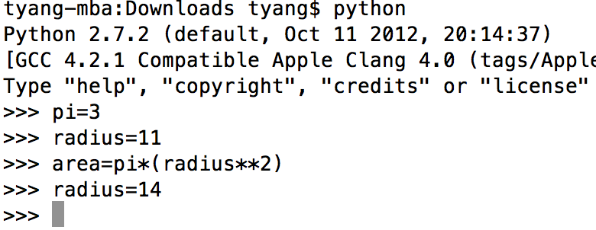
A Variable is just a Name
Assignment statement associates
The name to the left of the = symbol
With the object denoted by the expression to the right of the =
An object can have one, more than one, or no name associated with it

Slide 38
Objects
Scalar Type
Scalar objects are indivisible
Integer (int), e.g. 1, 2, 3, 4
Float (represent real numbers), e.g., 3.2, -29, 1.6E3
Boolean (bool): True or False
None: single value
Non-scalar Type
String, list, dict, …

Slide 39
Strings
>>> 'Hello, World!'
'Hello, World!'
>>>
>>> 'Hello, World!'
'Hello, World!'
>>> s = 'rock'
>>> t = 'climbing'
>>>
In addition to number and Boolean values, Python support string values
"Hello, World!"
'Hello, World!'
A string value is represented as a sequence of characters enclosed within quotes
A string value can be assigned to a variable

Slide 40
How to represent Strings
>>> 'Hello, World!'
'Hello, World!'
>>> "Hello, World”
'Hello, World!’
>>> '3'*'4'
Traceback (most recent call last):
File "<stdin>", line 1, in <module>
TypeError: can't multiply sequence by non-int of type 'str’
>>> print 'ab'
ab
>>> print 'a\nb'
a
b
>>> print 'he says \'hello\''
he says 'hello'
>>> print 'hello\tworld'
hello world
>>> print 'hello\bworld'
hellworld
>>> 'Hello, World!'
'Hello, World!'
>>> "Hello, World”
'Hello, World!’
>>> '3'*'4'
Traceback (most recent call last):
File "<stdin>", line 1, in <module>
TypeError: can't multiply sequence by non-int of type 'str’
>>>
>>> 'Hello, World!'
'Hello, World!'
>>> "Hello, World”
'Hello, World!’
>>>
>>> 'Hello, World!'
'Hello, World!'
>>>
Single Quotes are interchangeable with
Double quotes
Numbers in a string are treated as characters
Use backslash (\) character is used to escape characters that otherwise have a special meaning
chars | meaning
'\n' | newline
'\'' | Singe quote
'\"' | Double quote
'\t' | Horizontal tab
'\b' | Backspace
'\\' | backslash
https://docs.python.org/2.0/ref/strings.html

Slide 41
String operators
>>> 'Hello, World!'
'Hello, World!'
>>> s = 'rock'
>>> t = 'climbing'
>>> s == 'rock'
True
>>> s != t
True
>>> s < t
False
>>> s > t
True
>>> s + t
'rockclimbing'
>>> s + ' ' + t
'rock climbing'
>>> 5 * s
'rockrockrockrockrock'
>>> 30 * '_'
'______________________________'
>>> 'o' in s
True
>>> 'o' in t
False
>>> 'bi' in t
True
>>> len(t)
8
String is a non-scalar type
Usage | Explanation
x in s | x is a substring of s
x not in s | x is not a substring of s
s + t | Concatenation of s and t
s * n, n * s | Concatenation of n copies of s
s[i] | Character at index i of s
len(s) | (function) Length of string s
To view all operators, use the help() tool
>> help(str)
Help on class str in module builtins:
class str(object)
| str(string[, encoding[, errors]]) -> str
...

Slide 42
Exercise
Write Python expressions involving strings s1, s2, and s3 that correspond to:
'll' appears in s3
the blank space does not appear in s1
the concatenation of s1, s2, and s3
the blank space appears in the concatenation of s1, s2, and s3
the concatenation of 10 copies of s3
the total number of characters in the concatenation of s1, s2, and s3
>>> s1
'good'
>>> s2
'bad'
>>> s3
'silly'
>>>
>>> s1
'good'
>>> s2
'bad'
>>> s3
'silly'
>>> 'll' in s3
True
>>> ' ' not in s1
True
>>> s1 + s2 + s3
'goodbadsilly’
>>> ' ' in s1 + s2 + s3
False
>>> 10*s3
'sillysillysillysillysillysillysillysillysillysilly'
>>> len(s1+s2+s3)
12
>>>

Slide 43
Index and indexing operator
The index of an item in a sequence is its position with respect to the first item
The first item has index 0,
The second has index 1,
The third has index 2, …
The index of an item in a sequence is its position with respect to the first item
The index of an item in a sequence is its position with respect to the first item
The first item has index 0,
The second has index 1,
The index of an item in a sequence is its position with respect to the first item
The first item has index 0,
len(s) -1
The indexing operator [] can take a nonnegative index i and returns a string consisting of the single character at index i
s =
'A p p l e'
0
1
2
3
4
s[0] =
'A'
s[1] =
'p'
>>> s = 'Apple'
>>> s[0]
'A'
>>> s[1]
'p'
>>> s[4]
'e'
s[2] =
'p'
s[3] =
'l'
s[4] =
'e'

Slide 44
Negative index
A negative index is used to specify a position with respect to the “end”
The last item has index -1,
The second to last item has index -2,
The third to last item has index -3, …
len(s) -4
len(s) -1
-5
-4
-3
-2
-1
s =
'A p p l e'
0
1
2
3
4
s[-1] =
'e'
s[-2] =
'l'
>>> s = 'Apple'
>>> s[-1]
'e'
>>> s[-2]
'l'
>>> s[-5]
'A'
s[-5] =
'A'

Slide 45
Exercise
String s is defined to be
'abcdefgh'
Write expressions using s and the indexing operator [] that return the following strings:
'a'
'c'
'h'
'f'
>>> s = 'abcdefgh'
>>>
>>> s = 'abcdefgh'
>>> s[0]
'a'
>>> s[2]
'c'
>>> s[7]
'h'
>>> s[-1]
'h'
>>> s[-3]
'f'
>>>

Slide 46
Index and indexing operator
Use [i:j] to take a substring starts from index i and ends at index smaller than j
len(s) -1
s =
'A p p l e'
0
1
2
3
4
s[i:j]: substring from i, i+1, … j-1
>>> s = 'Apple'
>>> s[0:2]
'Ap'
>>> s[1:3]
'pp'
>>> s[0:]
‘Apple’
>>> s[:4]
‘Appl’
s[i:]: substring from i, i+1, … len(s)-1
s[:j]: substring from 0, i+1, … j-1

Slide 47
Using step size in index operator
Use [i:j:s] to take a substring starts from index i and ends at index smaller than j with step size s
len(s) -1
s =
'A p p l e'
0
1
2
3
4
>>> s = 'Apple'
>>> s[1:3:2]
'p'
>>> s[0::2]
'Ape'
>>> s[:3:2]
'Ap'
>>> s[-1::-1]
'elppA'
s[i:j:s]: substring from i, i+s, i+2*s,,, j-1 …
s[:j:s]: substring from 0, s, 2s, .. (<j)

Slide 48
Python program
print is useful in code saved in a file
line1 = 'Hello Python developer...'
A Python program is a sequence of Python statements
Stored in a text file called a Python module
Executed using an IDE or “from the command line”
line2 = 'Welcome to the world of Python!'
print line1
print line2
line1 = 'Hello Python developer...'
line2 = 'Welcome to the world of Python!’
print line1
print line2
line1 = 'Hello Python developer...'
line2 = 'Welcome to the world of Python!’
print line1
print line2
line1 = 'Hello Python developer...'
line2 = 'Welcome to the world of Python!’
print line1
print line2
line1 = 'Hello Python developer...'
line2 = 'Welcome to the world of Python!’
print line1
print line2
$ python hello.py
$ python hello.py
Hello Python developer…
Welcome to the world of Python!
line1 = 'Hello Python developer...'
line2 = 'Welcome to the world of Python!’
print line1
print line2
$ python hello.py
Hello Python developer…
hello.py

Slide 49
Output
>>> print 'ab'
ab
>>> print 'a\nb'
a
b
>>> x=3
>>> print x
>>> 3
>>> print x*2
>>> 6
>>> print x*3, 4
9 4
>>>
>>> print 'ab'
ab
>>> print 'a\nb'
a
b
>>> x=3
>>> print x
>>> 3
>>> print x*2
>>> 6
>>> print x*3, 4
9 4
Output:
print <expression> or <objects>
print <expression>,<objects>, …
Python 3.0: print(exp)
print(objects, …)
https://docs.python.org/2/tutorial/inputoutput.html

Slide 50
Built-in function print
Function print prints its input argument to the display window
The argument can be any object: an integer, a float, a string, a list, …
Strings are printed without quotes and “to be read by people”, rather than “to be interpreted by Python”,
The “string representation” of the object is printed
print always output string with a newline in the end
>>> print 0
0
>>> print 0.0
0.0
>>> print 'zero’
zero
>>> print [0, 1, 'two’]
[0, 1, 'two']
line='zero'
for c in line:
print c
printc.py
$ python printc.py
z
e
r
o

Slide 51
Input
>>> print 'ab'
ab
>>> print 'a\nb'
a
b
>>> x=3
>>> print x
>>> 3
>>> print x*2
>>> 6
>>> print x*3, 4
9 4
>>>
>>> print 'ab'
ab
>>> print 'a\nb'
a
b
>>> x=3
>>> print x
>>> 3
>>> print x*2
>>> 6
>>> print x*3, 4
9 4
>>> person = raw_input('Enter your name: ')
Enter your name: TB
>>> print person
>>> TB
get input from command line
input treated as string, assigned to variable
hint message
variable = raw_input(str)
Python 3.0
variable = input(str)
Python 2.7: input treated as python expression (not recommended)

Slide 52
Built-in function raw_input()
Function raw_input() requests and reads input from the user interactively
It’s (optional) input argument is the request message
Typically used on the right side of an assignment statement
>>> name = raw_input('Enter your name: ')
>>> name = raw_input('Enter your name: ')
Enter your name: Michael
>>> name = raw_input('Enter your name: ')
Enter your name: Michael
>>>
>>> name = raw_input('Enter your name: ')
Enter your name:
>>> name = raw_input('Enter your name: ')
Enter your name: Michael
>>> print name
Michael
When executed:
>>> name = raw_input('Enter your name: ')
Enter your name: Michael
>>> name
'Michael'
When executed:
The input request message is printed
When executed:
The input request message is printed
The user enters the input
The string typed by the user is assigned to the variable on the left side of the assignment statement
When executed:
The input request message is printed
The user enters the input

Slide 53
Exercise
Write a python script that requests user to input first name and last name and then print a message
Hello First-Name Last-Name
Welcome to the World of Python
first = raw_input('Enter your first name: ')
last = raw_input('Enter your last name: ')
line1 = 'Hello ' + first + ' ' + last + '…'
print line1
print 'Welcome to the world of Python!'
input.py

Slide 54
Type Conversion
>>> number = raw_input('Enter an integer: ')
Enter an integer: 8
>>> number/4
Traceback (most recent call last):
File "<stdin>", line 1, in <module>
TypeError: unsupported operand type(s) for /: 'str' and 'int'
>>>
>>> number = raw_input('Enter an integer: ')
Enter an integer: 8
>>> number/4
Traceback (most recent call last):
File "<stdin>", line 1, in <module>
TypeError: unsupported operand type(s) for /: 'str' and 'int'
>>> type(number)
<type 'str’>
>>>
>>> number = raw_input('Enter an integer: ')
Enter an integer: 8
>>> number/4
Traceback (most recent call last):
File "<stdin>", line 1, in <module>
TypeError: unsupported operand type(s) for /: 'str' and 'int'
>>> type(number)
<type 'str’>
>>> n = int(number)
>>> n/4
>>> 2
What if you want get a number from user and assign to a variable?
Type conversion:
int(‘3’)
float(‘3.2’)

Slide 55
More Type conversion
bool
int
float
Implicit type conversion
When evaluating an expression that contains operands of different types, operands must first be converted to the same type
Operands are converted to the type that “contains the others”
Explicit type conversion
Constructors can be used to explicitly convert types
>>> 2 + 3.0
5.0
>>> True + 0
1
>>> int(2.1)
2
>>> int('456')
456
>>> int('45.6')
Traceback (most recent call last):
File "<pyshell#59>", line 1, in <module>
int('45.6')
ValueError: invalid literal for int() with base 10: '45.6’
>>> float('45.6')
45.6
>>> float(2**24)
16777216.0
>>>>>
>>> str(345)
'345'
>>> str(34.5)
'34.5'
>>>
int() creates an int object
from a float object, by removing decimal part
from a str object, if it represents an integer
float() creates a float object
from an int object, if it is not too big
from a string, if it represents a number
str() creates a str object
the string representation of the object value

Slide 56
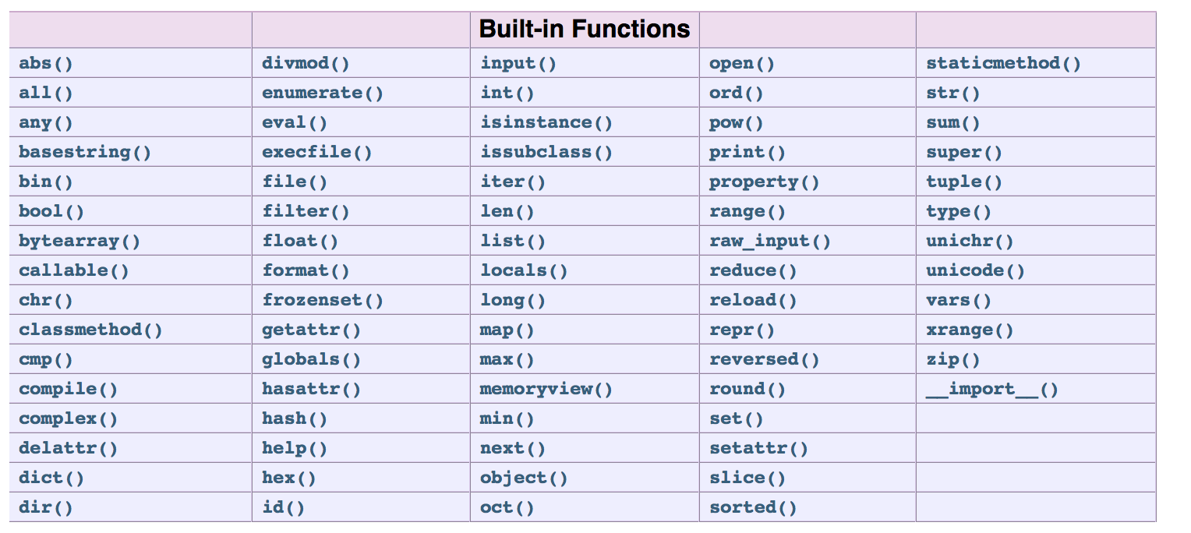
All Built-in functions
https://docs.python.org/2/library/functions.html#all

Slide 57
Exercise
Write a program that:
Requests the user’s name
Requests the user’s age
Computes the user’s age one year from now and prints the message shown
$ python nameage.py
Enter your name: Marie
Enter your age: 17
Marie, you will be 18 next year!
name = raw_input('Enter your name: ')
age = int(raw_input('Enter your age: '))
line = name + ', you will be ' + str(age+1) + ' next year!’
print line
nameage.py

Slide 58
Exercise
Write a program that:
Requests the user’s name
Requests the user’s age
Prints a message saying whether the user is eligible to vote or not
Need a way to execute a Python statement
if a condition is true

Slide 59
Introduction to Python
Programming Languages
Basic Elements of Python
Branching Programs
Iteration

Slide 60
Branching Programs
Execution control structures are programming language statements that control which statements are executed, i.e., the execution flow of the program
Conditional Structure: One-way if statement
Conditional Structure: Two-way if statement
Iteration Structure: While loop
Iteration Structure: For loop

Slide 61
Conditional Structure
Code
Code
Test
Test
True
True
False
False
Code
Code
Code
Code
Code
two-way if statement
One-way if statement

Slide 62
One-way if statement
if <bool expre>:
<indented code block>
<non-indented statement>
if temp > 86:
print 'It is hot!'
print 'Be sure to drink liquids.’
print 'Goodbye.'
if temp > 86:
print 'It is hot!'
print 'Be sure to drink liquids.’
print 'Goodbye.’
if temp > 86:
print 'It is hot!'
print 'Be sure to drink liquids.'
print 'Goodbye.'
The value of temp is 50.
The value of temp is 90.
temp > 86:
True
print 'It is hot!'
False
print 'Be sure to drink liquids.'
print 'Goodbye.'

Slide 63
Exercises
Write corresponding if statements:
If age is greater than 62 then print 'You can get Social Security benefits’
If string 'large bonuses' appears in string report then print 'Vacation time!’
If hits is greater than 10 and shield is 0 then print "You're dead..."
>>> hits = 12
>>> shield = 0
>>> if hits > 10 and shield == 0:
print "You're dead..."
You're dead...
>>> hits, shield = 12, 2
>>> if hits > 10 and shield == 0:
print "You're dead..."
>>>
>>> age = 45
>>> if age > 62:
print 'You can get Social Security benefits'
>>> age = 65
>>> if age > 62:
print 'You can get Social Security benefits'
You can get Social Security benefits
>>>
>>> report = 'no bonuses this year'
>>> if 'large bonuses' in report:
print 'Vacation time!'
>>> report = 'large bonuses this year'
>>> if 'large bonuses' in report:
print 'Vacation time!'
Vacation time!

Slide 64
Indentation is critical
if temp > 86:
print 'It is hot!'
print 'Drink liquids.'
print 'Goodbye.'
if temp > 86:
print 'It is hot!'
print 'Drink liquids. '
print 'Goodbye.'
temp > 86:
temp > 86:
True
True
print 'It is hot!'
print 'It is hot!'
False
False
print 'Drink liquids.'
print 'Drink liquids.'
print 'Goddbye.'
print 'Goddbye.'

Slide 65
Two-way if statement
if <condition>:
<indented code block 1>
else:
<indented code block 2>
<non-indented statement>
if temp > 86:
print 'It is hot!'
print 'Be sure to drink liquids.'
else:
print 'It is not hot.'
print 'Bring a jacket.’
print 'Goodbye.’
if temp > 86:
print 'It is hot!'
print 'Be sure to drink liquids.'
else:
print 'It is not hot.'
print 'Bring a jacket.’
print 'Goodbye.'
if temp > 86:
print 'It is hot!'
print 'Be sure to drink liquids.'
else:
print 'It is not hot.'
print 'Bring a jacket.’
print 'Goodbye.'
The value of temp is 50.
The value of temp is 90.
temp > 86:
False
True
print 'It is not hot!'
print 'It is hot!'
print 'Bring a jacket.'
print 'Be sure to drink liquids.'
print 'Goodbye.'

Slide 66
Exercise
Write a program that:
Requests the user’s name
Requests the user’s age
Prints a message saying whether the user is eligible to vote or not
>>>
Enter your name: Marie
Enter your age: 17
Marie, you can't vote.
>>> ============RESTART================
>>>
Enter your name: Marie
Enter your age: 18
Marie, you can vote.
>>>
name = raw_input('Enter your name: ')
age = eval(raw_input('Enter your age: '))
if age < 18:
print name + ", you can't vote."
else:
print name + ", you can vote."
vote.py

Slide 67
Multiple-way if statement
if <condition>:
<indented code block 1>
elif <condition>:
<indented code block 2>
elif <condition>:
<indented code block 3>
else:
<indented code block n>
<non-indented statement>
if temp > 86:
print 'It is hot!'
print 'Be sure to drink liquids. '
elif temp>72:
print 'It is warm.'
print 'Bring a jacket.’
else:
print 'It is cold'
print ‘Bring a down jacket'
print 'Goodbye.'
if temp > 86:
print 'It is hot!'
print 'Be sure to drink liquids. '
elif temp>72:
print 'It is warm.'
print 'Bring a jacket.’
else:
print 'It is cold'
print ‘Bring a down jacket'
print 'Goodbye.'
if temp > 86:
print 'It is hot!'
print 'Be sure to drink liquids. '
elif temp>72:
print 'It is warm.'
print 'Bring a jacket.’
else:
print 'It is cold'
print ‘Bring a down jacket'
print 'Goodbye.'
if temp > 86:
print 'It is hot!'
print 'Be sure to drink liquids. '
elif temp>72:
print 'It is warm.'
print 'Bring a jacket.’
else:
print 'It is cold'
print ‘Bring a down jacket'
print 'Goodbye.'
The value of temp is 90.
The value of temp is 80.
The value of temp is 60.

Slide 68
Iteration Structure
Code
Recipe from a cookbook
Put custard mixture over heat
Stir
Dip spoon in custard
Remove spoon and run finger across back of spoon
if clear path is left, remove custard from heat and let cool
otherwise repeat from step 2
Test
Loop
False
True
test
Code
Code

Slide 69
while loop
parentheses not necessary
Executes a code block for until test is false
Block of code must be indented
while (bool exp):
<indented code block >
<non-indented code block>
ans=0
i=1
while (i<=10):
ans = ans + i
i = i+1
print ans
careful: if bug exists, while loop never stop

Slide 70
for loop
Executes a code block for every item of a sequence
Sequence can be a string, a list, …
Block of code must be indented
for <variable> in <sequence>:
<indented code block >
<non-indented code block>
for v in 'a1c2':
if v in '123456789':
print v
print 'Done.'
v =
'a'
v =
'1'
>>>
1
2
Done.
>>>
>>>
1
2
>>>
b
d
Done.
>>>
1
v =
'c'
v =
'2'

Slide 71
Built-in function range()
Function range() is used to iterate over a sequence of numbers in a specified range
To iterate over the n numbers 0, 1, 2, …, n-1
for i in range(n):
To iterate i, i+1, i+2, …, n-1
for i in range(i, n):
To iterate i, i+c, i+2c, i+3c, …, n-1
for i in range(i, n, c):
>>> for i in range(2, 16, 10):
print(i)
2
12
>>>
>>> for i in range(2, 3):
print(i)
2
>>>
>>> for i in range(2, 2):
print(i)
>>>
>>> for i in range(4):
print(i)
0
1
2
3
>>>
>>> for i in range(0):
print(i)
>>>
>>> for i in range(1):
print(i)
0
>>>
>>> for i in range(2, 6):
print(i)
2
3
4
5
>>>
>>> for i in range(2, 16, 4):
print(i)
2
6
10
14
>>>
>>> for i in range(0, 16, 4):
print(i)
0
4
8
12
>>>

Slide 72
Exercise
Write for loops that will print the following sequences:
0, 1, 2, 3, 4, 5, 6, 7, 8 , 9, 10
1, 2, 3, 4, 5, 6, 7, 8, 9
0, 2, 4, 6, 8
1, 3, 5, 7, 9
20, 30, 40, 50, 60

Slide 73
terminate the loop using break
The loop can be terminated using break
for v in 'a1c2':
if v in '123456789’:
print v
break
print 'Done.'
1
Done.

Slide 74
terminate the loop using break
The break terminates the smallest enclosing loop
for n in range(2, 10):
for x in range(2,n):
if n%x == 0:
print n, 'equals', x, '*', n/x
break
4 equals 2 * 2
6 equals 2 * 3
8 equals 2 * 4
9 equals 3 * 3

Slide 75
Continue to the next iteration
The continue statement continues with the next iteration of the loop
for num in range(2, 10):
if num % 2 == 0:
print "Found an even number", num
continue
print "Found a number", num
Found an even number 2
Found a number 3
Found an even number 4
Found a number 5
Found an even number 6
Found a number 7
Found an even number 8
Found a number 9

Slide 76
Functions, Scoping and Abstractions
Functions
Scoping
Specifications
Modules
Files

Slide 77
So far
Square root of a number
Numbers, strings
Assignments
input/output
Comparisons
Execution control structures
x = 25
epsilon = 0.01
numGuesses = 0
left = 0.0
right = max(1.0, x)
guess = (left +right)/2.0
while abs(guess**2 - x) >= epsilon:
print 'left =', left, 'right =', right, 'guess =', guess
numGuesses += 1
if guess**2 < x:
left = guess
else:
right = guess
guess = (left + right)/2.0
print 'numGuesses =', numGuesses
print guess, 'is close to square root of', x
Turing Complete

Slide 78
Functions, Scoping and Abstractions
Functions
Scoping
Specifications
Modules
Files

Slide 79
The purpose of functions
Wrapping code into functions has several desirable goals:
Modularity (Decomposition): The complexity of developing a large program can be dealt with by breaking down the program into smaller, simpler, self-contained pieces. Each smaller piece (e.g., function) can be designed, implemented, tested, and debugged independently.
Code reuse: A fragment of code that is used multiple times in a program—or by multiple programs— should be packaged in a function. The program ends up being shorter, with a single function call replacing a code fragment, and clearer, because the name of the function can be more descriptive of the action being performed by the code fragment. Debugging also becomes easier because a bug in the code fragment will need to be fixed only once.
Encapsulation (Abstraction): A function hides its implementation details from the user of the function; removing the implementation details from the developer’s radar makes her job easier.

Slide 80
Define a function
def name_of_function (list of formal parameters):
body of function
def my_max (x, y):
print 'the maximum of ', x , ' and ', y, ' is '
if x > y:
return x
else:
return y
max.py
The code in the definition of a function is executed only if it is called
>>> a, b = 3, 4
>>> from max import *
>>> my_max(a, b)
the maximum of 3 and 4 is
4

Slide 81
What happened when a function is called
formal parameters
def my_max (x, y):
print 'the maximum of ', x , ' and ', y, ' is '
if x > y:
return x
else:
return y
max.py
actual parameters (arguments)
The expression that make up the actual parameters are evaluated, and the formal parameters of the functions are bounded to the resulting values.
The point of execution moves to the first statement of the function
>>> a, b = 3, 4
>>> from max import *
>>> my_max(a, b)
the maximum of 3 and 4 is
4
The code in the body of function is executed until a return statement is returned or there are no more statements to execute. In the first case, the value of the expression following return becomes the value of the function call. In the second case, the function returns None
The value of the call is the returned value

Slide 82
Actual parameters
Variables
Expressions
Function call is an expression
my_max(a, b)
my_max(3*a, b)
my_max(my_max(3, a), b)

Slide 83

Formal parameters assignment
def printName(firstName, lastName, reverse):
if reverse:
print lastName + ', ' + firstName
else:
print firstName, lastName
printName.py
1. Positional: printName(‘Bruce’, ‘Lee’, False)
2. Key word:
printName(‘Bruce’, ‘Lee’, reverse = False)
printName(‘Bruce’, lastName=‘Lee’, reverse=False)
printName(firstName=‘Bruce’, lastName=‘Lee’, reverse=False)
printName(lastName=‘Lee’, reverse = False, firstName=‘Bruce’)
printName(firstName=‘Bruce’, ‘Lee’, False)
non-keyword argument cannot follow keyword argument

Slide 84
Default parameter values
def printName(firstName, lastName, reverse = False):
if reverse:
print lastName + ', ' + firstName
else:
print firstName, lastName
def printName(firstName=’Bruce', lastName, reverse = False):
if reverse:
print lastName + ', ' + firstName
else:
print firstName, lastName
non-default argument cannot follow default argument
printName(‘Bruce’, ‘Lee’)
printName(‘Bruce’, ‘Lee’, True)
printName(‘Bruce’, ‘Lee’, reverse = True)

Slide 85
An example
def f(x): #name x used as formal parameter
y = 1
x = x + y
print 'x =', x
return x
x = 3
y = 2
z = f(x) #value of x used as actual parameter
print 'z =', z
print 'x =', x
print 'y =', y
local.py
x = 4
z = 4
x = 3
y = 2
x =
z =
x =
y =
What is going on?

Slide 86
Functions, Scoping and Abstractions
Functions
Scoping
Specifications
Modules
Files

Slide 87
Function defines a new name space (scope)
>>> x, y = 20, 50
>>>
>>> x, y = 20, 50
>>> res = double(5)
x = 2, y = 5
>>> x, y
(20, 50)
>>>
>>> x, y = 20, 50
>>> res = double(5)
Even during the execution of double(), local variables x and y are invisible outside of the function!
def double(y):
x=2
print 'x = {}, y = {}'.format(x,y)
return x*y
How is it possible that the values of x and y do not interfere with each other?
Every function call has a namespace
in which local variables are stored
x
y
y
x
shell
Function call double(5)
20
50
5
2

Slide 88
Functions, Scoping and Abstractions
Functions
Scoping
Specifications
Modules
Files

Slide 89
docstring of a function
def findRoot(x, power, epsilon):
"""Assumes x and epsilon int or float, power an int,
epsilon > 0 & power >= 1
Returns float y such that y**power is within epsilon of x.
If such a float does not exist, it returns None"""
if x < 0 and power%2 == 0:
return None
low = min(-1.0, x)
high = max(1.0, x)
ans = (high + low)/2.0
while abs(ans**power - x) >= epsilon:
if ans**power < x:
low = ans
else:
high = ans
ans = (high + low)/2.0
return ans
findRoot.py

Slide 90
Specification
docstring of a function describes the specification of a function that
Defines a contract between the implementer of a function and those who will use the function
The contract contain two parts:
assumptions: conditions that must be met by the users of the function. Typically they describe the constraints on the actual parameters
Guarantees: conditions that must be met by the functions provided it has been called that satisfies the assumptions.

Slide 91
docstring of a function
def findRoot(x, power, epsilon):
"""Assumes x and epsilon int or float, power an int,
epsilon > 0 & power >= 1
Returns float y such that y**power is within epsilon of x.
If such a float does not exist, it returns None"""
if x < 0 and power%2 == 0:
return None
low = min(-1.0, x)
high = max(1.0, x)
ans = (high + low)/2.0
while abs(ans**power - x) >= epsilon:
if ans**power < x:
low = ans
else:
high = ans
ans = (high + low)/2.0
return ans
findRoot.py

Slide 92
Functions, Scoping and Abstractions
Functions
Scoping
Specifications
Modules
Files

Slide 93
Modules
A module is a file containing Python code.
When the module is executed (imported), then the module is (also) a namespace.
This namespace has a name, typically the name of the module.
In this namespace live the names that are defined in the global scope of the module: the names of functions, values, and classes defined in the module.
When the module is executed (imported), then the module is (also) a namespace.
When the module is executed (imported), then the module is (also) a namespace.
This namespace has a name, typically the name of the module.
When the module is executed (imported), then the module is (also) a namespace.
This namespace has a name, typically the name of the module.
In this namespace live the names that are defined in the global scope of the module: the names of functions, values, and classes defined in the module.
These names are the module’s attributes.
Built-in function dir() returns the names defined in a namespace
>>> import math
>>> dir(math)
['__doc__', '__file__', '__name__', '__package__', 'acos', 'acosh', 'asin', 'asinh', 'atan', 'atan2', 'atanh', 'ceil', 'copysign', 'cos', 'cosh', 'degrees', 'e', 'erf', 'erfc', 'exp', 'expm1', 'fabs', 'factorial', 'floor', 'fmod', 'frexp', 'fsum', 'gamma', 'hypot', 'isfinite', 'isinf', 'isnan', 'ldexp', 'lgamma', 'log', 'log10', 'log1p', 'modf', 'pi', 'pow', 'radians', 'sin', 'sinh', 'sqrt', 'tan', 'tanh', 'trunc’]
>>>
>>> import math
>>> dir(math)
['__doc__', '__file__', '__name__', '__package__', 'acos', 'acosh', 'asin', 'asinh', 'atan', 'atan2', 'atanh', 'ceil', 'copysign', 'cos', 'cosh', 'degrees', 'e', 'erf', 'erfc', 'exp', 'expm1', 'fabs', 'factorial', 'floor', 'fmod', 'frexp', 'fsum', 'gamma', 'hypot', 'isfinite', 'isinf', 'isnan', 'ldexp', 'lgamma', 'log', 'log10', 'log1p', 'modf', 'pi', 'pow', 'radians', 'sin', 'sinh', 'sqrt', 'tan', 'tanh', 'trunc’]
>>> math.sqrt
<built-in function sqrt>
>>> math.pi
3.141592653589793
>>> import math
>>>
To access the imported module’s attributes, the name of the namespace must be specified

Slide 94
The Python search path
By just adding folder /Users/me to the search path, module example can be imported
Suppose we want to import module example stored in folder /Users/me that is not in list sys.path
names in the shell namespace; note that example is not in
no folder in the Python search path contains module example
>>> ================ RESTART ================
>>> dir()
['__builtins__', '__doc__', '__name__', '__package__']
>>>
'an example module'
def f():
'function f'
print('Executing f()')
def g():
'function g'
print('Executing g()')
x = 0 # global var
>>> ================ RESTART ================
>>> dir()
['__builtins__', '__doc__', '__name__', '__package__']
>>> import example
Traceback (most recent call last):
File "<pyshell#79>", line 1, in <module>
import example
ImportError: No module named example
>>>
>>> ================ RESTART ================
>>>
>>> ================ RESTART ================
>>> dir()
['__builtins__', '__doc__', '__name__', '__package__']
>>> import example
Traceback (most recent call last):
File "<pyshell#79>", line 1, in <module>
import example
ImportError: No module named example
>>> import sys
>>> sys.path.append('/Users/me')
>>> import example
>>> example.f
<function f at 0x10278dc88>
>>> example.x
0
>>>
>>> ================ RESTART ================
>>> dir()
['__builtins__', '__doc__', '__name__', '__package__']
>>> import example
Traceback (most recent call last):
File "<pyshell#79>", line 1, in <module>
import example
ImportError: No module named example
>>> import sys
>>> sys.path.append('/Users/me')
>>> import example
>>> example.f
<function f at 0x10278dc88>
>>> example.x
0
>>> dir()
['__builtins__', '__doc__', '__name__', '__package__', 'example', 'sys’]
example.py
When called without an argument, function dir() returns the names in the top-level module
the shell, in this case.

Slide 95
Three ways to import module attributes
'an example module'
def f():
'function f'
print('Executing f()')
def g():
'function g'
print('Executing g()')
x = 0 # global var
1. Import the (name of the) module
>>>
>>> import example
>>>
>>> import example
>>> example.x
0
>>> example.f
<function f at 0x10278dd98>
>>> example.f()
Executing f()
>>>
example.py
example
f
g
x
namespace __main__
module example
f()
g()
0

Slide 96
Three ways to import module attributes
'an example module'
def f():
'function f'
print('Executing f()')
def g():
'function g'
print('Executing g()')
x = 0 # global var
2. Import specific module attributes
>>> from example import f
>>>
>>> from example import f
>>> f()
Executing f()
>>> x
Traceback (most recent call last):
File "<pyshell#28>", line 1, in <module>
x
NameError: name 'x' is not defined
>>>
>>>
example.py
f
f
g
x
namespace __main__
module example
f()
g()
0

Slide 97
Three ways to import module attributes
'an example module'
def f():
'function f'
print('Executing f()')
def g():
'function g'
print('Executing g()')
x = 0 # global var
3. Import all module attributes
>>> from example import *
>>> f()
Executing f()
>>> g()
Executing g()
>>> x
0
>>> example.x
NameError: name ‘example’ is not defined
>>>
>>> from example import *
>>>
example.py
f
g
x
f
g
x
namespace __main__
module example
f()
g()
0

Slide 98
Functions, Scoping and Abstractions
Functions
Scoping
Specifications
Modules
Files

Slide 99
Opening and closing a file
Processing a file consists of:
Opening the file
Reading from and/or writing to the file
Closing the file
File mode 'r' is used to
open a file for reading (rather than, say, writing)
The second (optional) argument is the file mode
Built-in function open() is used to open a file
The first input argument is the file pathname, whether absolute or relative with respect to the current working directory
Returns a “file” object
>>> infile = open('sample.txt')
Traceback (most recent call last):
File "<pyshell#50>", line 1, in <module>
infile = open('sample.txt')
IOError: [Errno 2] No such file or directory: 'sample.txt'
>>>
>>> infile = open('sample.txt')
Traceback (most recent call last):
File "<pyshell#50>", line 1, in <module>
infile = open('sample.txt')
IOError: [Errno 2] No such file or directory: 'sample.txt'
>>> infile = open('example.txt', 'r')
>>>
>>> infile = open('sample.txt')
Traceback (most recent call last):
File "<pyshell#50>", line 1, in <module>
infile = open('sample.txt')
IOError: [Errno 2] No such file or directory: 'sample.txt'
>>> infile = open('example.txt', 'r')
>>> infile.close()
>>>
A “file” object is of a type that supports several “file” methods, including method close() that closes the file

Slide 100
Open file mode
The file mode defines how the file will be accessed
Mode | Description
r | Reading (default)
w | Writing (if file exists, content is wiped)
a | Append (if file exists, writes are appended)
r+ | Reading and Writing
t | Text (default)
b | Binary
>>> infile = open('example.txt', 'rt')
>>> infile = open('example.txt', 'r')
>>> infile = open('example.txt', 't')
>>> infile = open('example.txt')
These are all equivalent

Slide 101
Close a file
Whenever you open a file, you should close it when it is not useful
fh=open(filename, 'rt')
.
.
.
.
.
fh.close()

Slide 102
File methods
Methods read() and readline() return the characters read as a string
Methods readlines() returns the characters read as a list of lines
Method write() returns the number of characters written
There are several “file” types; they all support similar “file” methods
Usage | Description
infile.read(n) | Read n characters starting from cursor; if fewer than n characters remain, read until the end of file
infile.read() | Read starting from cursor up to the end of the file
infile.readline() | Read starting from cursor up to, and including, the end of line character
infile.readlines() | Read starting from cursor up to the end of the file and return list of lines
outfile.write(s) | Write string s to file outfile starting from cursor
infile.close() | Close file infile

Slide 103
Reading a file
1 The 3 lines in this file end with the new line character.\n
2 \n
3 There is a blank line above this line.\n
⌃
⌃
⌃
⌃
⌃
example.txt
When the file is opened, a cursor is associated with the opened file
>>> infile = open('example.txt')
>>>
>>> infile = open('example.txt')
>>> infile.read(1)
'T'
>>> infile.read(5)
'he 3 '
>>> infile.readline()
'lines in this file end with the new line character.\n'
>>>
>>> infile = open('example.txt')
>>> infile.read(1)
'T'
>>> infile.read(5)
'he 3 '
>>> infile.readline()
'lines in this file end with the new line character.\n'
>>> infile.read()
'\nThere is a blank line above this line.\n'
>>>
>>> infile = open('example.txt')
>>> infile.read(1)
'T'
>>> infile.read(5)
'he 3 '
>>> infile.readline()
'lines in this file end with the new line character.\n'
>>> infile.read()
'\nThere is a blank line above this line.\n'
>>> infile.close()
>>>
>>> infile = open('example.txt')
>>> infile.read(1)
'T'
>>>
>>> infile = open('example.txt')
>>> infile.read(1)
'T'
>>> infile.read(5)
'he 3 '
>>>
The initial position of the cursor is:
at the beginning of the file, if file mode is r
at the end of the file, if file mode is a or w

Slide 104
Patterns for reading a text file
Why there is a empty line?
The most common usage for reading a file:
Read Line by Line and Do some Processing
Example:
>>> from readLines import *
>>> readLines('course.txt')
This is a computer science course
Its name is Python programming!
>>>
def readLines(filename):
infile = open(filename, 'r')
for line in infile:
print line
infile.close()
readLines.py
This is a computer science course
Its name is Python programming!
course.txt

Slide 105
Patterns for reading a text file
The most common usage for reading a file:
Read Line by Line and Do some Processing
>>> from readLines import *
>>> readLines('course.txt')
This is a computer science course
Its name is Python programming!
>>>
Example:
def readLines(filename):
infile = open(filename, 'r')
for line in infile:
print line.rstrip('\n')
infile.close()
s.rstrip([chars])
readLines.py
>>> ' spacious '.rstrip()
' spacious'
>>> 'mississippi'.rstrip('ipz')
'mississ'
This is a computer science course
Its name is Python programming!
course.txt

Slide 106
Patterns for reading a text file
Common patterns for reading a file:
Read the file content into a string
Read the file content into a list of words
Read the file content into a list of lines
Example:
def numChars(filename):
'returns the number of characters in file filename'
infile = open(filename, 'r')
content = infile.read()
infile.close()
return len(content)
def numWords(filename):
'returns the number of words in file filename'
infile = open(filename)
content = infile.read()
infile.close()
wordList = content.split()
return len(wordList)
def numLines(filename):
'returns the number of lines in file filename'
infile = open(filename, 'r’)
lineList = infile.readlines()
infile.close()
return len(lineList)

Slide 107
Writing to a text file
1 This is the first line.
2
3
4
1 This is the first line. Still the first line…\n
2 Now we are in the second line.\n
3 Non string value like 5 must be converted first.\n
4 Non string value like 5 must be converted first.\n
1
2
3
4
1 T
2
3
4
1 This is the first line. Still the first line…\n
2
3
4
1 This is the first line. Still the first line…\n
2 Now we are in the second line.\n
3
4
1 This is the first line. Still the first line…\n
2 Now we are in the second line.\n
3 Non string value like 5 must be converted first.\n
4
⌃
⌃
⌃
⌃
⌃
⌃
⌃
test.txt
>>> outfile = open('test.txt', 'w')
>>> outfile.write('T')
1
>>>
>>> outfile = open('test.txt', 'w')
>>> outfile.write('T')
1
>>> outfile.write('his is the first line.')
22
>>> outfile.write(' Still the first line...\n')
25
>>> outfile.write('Now we are in the second line.\n')
31
>>>
>>> outfile = open('test.txt', 'w')
>>>
>>> outfile = open('test.txt', 'w')
>>> outfile.write('T')
1
>>> outfile.write('his is the first line.')
22
>>>
>>> outfile = open('test.txt', 'w')
>>> outfile.write('T')
1
>>> outfile.write('his is the first line.')
22
>>> outfile.write(' Still the first line...\n')
25
>>>
>>> outfile = open('test.txt', 'w')
>>> outfile.write('T')
1
>>> outfile.write('his is the first line.')
22
>>> outfile.write(' Still the first line...\n')
25
>>> outfile.write('Now we are in the second line.\n')
31
>>> outfile.write('Non string value like '+str(5)+' must be converted first.\n')
49
>>>
>>> outfile = open('test.txt', 'w')
>>> outfile.write('T')
1
>>> outfile.write('his is the first line.')
22
>>> outfile.write(' Still the first line...\n')
25
>>> outfile.write('Now we are in the second line.\n')
31
>>> outfile.write('Non string value like '+str(5)+' must be converted first.\n')
49
>>> outfile.write('Non string value like {} must be converted first.\n'.format(5))
49
>>> outfile.close()

Slide 108
Structured Data Types
Tuples
Lists
Dictionaries

Slide 109
Tuple
Tuple is an ordered sequence of elements. The elements could be any type
>>> t1=()
>>> t2=(1, 'two', 3)
>>> print t1
()
>>> print t2
(1, 'two', 3)
>>> t2[2]
3
>>> t2[1]
>>> 'two’
>>> t1=()
>>> t2=(1, 'two', 3)
>>> print t1
()
>>> print t2
(1, 'two', 3)
>>> t2[2]
3
>>> t2[1]
>>> 'two’
>>> t3=(1)
>>> t3
1
>>>
>>> t1=()
>>> t2=(1, 'two', 3)
>>> print t1
()
>>> print t2
(1, 'two', 3)
>>> t2[2]
3
>>> t2[1]
>>> 'two’
>>> t3=(1)
>>> t3
1
>>> t3=(1,)
>>> t3
(1,)

Slide 110
Tuple: operations and methods
Like Strings, tuples can be concatenated, indexed and sliced
>>> t1=(1, 'two', 3)
>>> t2=(t1, 3.25)
>>> print t2
((1, 'two', 3), 3.25)
>>> t2[0]
(1, 'two',3)
>>> t1 + t2
>>> (1, 'two', 3, (1, 'two', 3), 3.25)
>>> (t1 + t2)[3]
(1, 'two', 3)
>>> (t1 + t2)[2:5]
(3, (1, 'two', 3), 3.25)
>>> t1*3
>>> (1, 'two', 3, 1, 'two', 3, 1, 'two', 3)

Slide 111
Tuple: operations and methods
for statement can be used to iterate over elements of a tuple
def findDivisors (n1, n2):
"""Assumes that n1 and n2 are positive ints
Returns a tuple containing all common divisors of n1 & n2"""
divisors = () #the empty tuple
for i in range(1, min (n1, n2) + 1):
if n1%i == 0 and n2%i == 0:
divisors = divisors + (i,)
return divisors
divisors = findDivisors(20, 100)
print divisors
total = 0
for d in divisors:
total += d
print total
commonDivisor.py

Slide 112
Multiple Assignments
A fixed length of sequence can be used for multiple assignments
>>> t=(3,4)
>>> x, y = t
>>> x
3
>>> y
4
>>> a, b, c = 'two'
>>> a
't'
>>> b
'w’
>>> c
'o'
Useful with functions that return fixed-size sequences

Slide 113
Return multiple values in a function
def findExtremeDivisors(n1, n2):
"""Assumes that n1 and n2 are positive ints
Returns a tuple containing the smallest common
divisor > 1 and the largest common divisor of n1
and n2"""
divisors = () #the empty tuple
minVal, maxVal = None, None
for i in range(2, min(n1, n2) + 1):
if n1%i == 0 and n2%i == 0:
if minVal == None or i < minVal:
minVal = i
if maxVal == None or i > maxVal:
maxVal = i
return (minVal, maxVal)
extremeDivisor.py
>>> from extremeDivisor import *
>>> minDivisor, maxDivisor = findExtremeDivisor(100, 200)

Slide 114
Tuples are immutable
Cannot assign a new value to the elements of a tuple
>>> t=(3,4)
>>> t[0]=4
---------------------------------------------------------------------------TypeError Traceback (most recent call last)<ipython-input-60-db906a64ea2d> in <module>()----> 1 t[0]=4TypeError: 'tuple' object does not support item assignment

Slide 115
Structured Data Types
Tuples
Lists
Definition
Operations
Side effect of Mutability
Strings and lists
Dictionaries

Slide 116
Lists: mutable sequence
In addition to number, Boolean, and string values, Python supports lists
['ant', 'bat', 'cod', 'dog', 'elk']
[0, 1, 'two', 'three', [4, 'five']]
[0, 1, 2, 3, 4, 5, 6, 7, 8, 9, 10]
A comma-separated sequence of items enclosed within square brackets
The items can be numbers, strings, and even other lists
>>> pets = ['ant', 'bat', 'cod', 'dog', 'elk']
>>> lst = [0, 1, 'two', 'three', [4, 'five']]
>>> nums = [0, 1, 2, 3, 4, 5, 6, 7, 8, 9, 10]
>>>
>>> pets = ['ant', 'bat', 'cod', 'dog', 'elk']
>>> lst = [0, 1, 'two', 'three', [4, 'five']]
>>>
>>> pets = ['ant', 'bat', 'cod', 'dog', 'elk’]
>>>

Slide 117
List operators and functions
>>> lst = [1, 2, 3]
>>> lstB = [0, 4]
>>> 4 in lst
False
>>> 4 not in lst
True
>>> lst + lstB
[1, 2, 3, 0, 4]
>>> 2*lst
[1, 2, 3, 1, 2, 3]
>>> lst[0]
1
>>> lst[1]
2
>>> lst[-1]
3
>>> len(lst)
3
>>> min(lst)
1
>>> max(lst)
3
>>> sum(lst)
6
>>> help(list)
...
Like strings, lists can be manipulated with operators and functions
Usage | Explanation
x in lst | x is an item of lst
x not in lst | x is not an item of lst
lst + lstB | Concatenation of lst and lstB
lst*n, n*lst | Concatenation of n copies of lst
lst[i] | Item at index i of lst
len(lst) | Number of items in lst
min(lst) | Minimum item in lst
max(lst) | Maximum item in lst
sum(lst) | Sum of items in lst

Slide 118
Lists are mutable, strings are not
Lists can be modified
Lists can be modified; they are said to be mutable
pets = ['ant', 'bat', 'cod', 'dog', 'elk']
pets = ['ant', 'bat', 'cow', 'dog', 'elk']
Strings and Tuples can’t be modified; they are said to be immutable
Strings and Tuples can’t be modified
pet = 'cod'
>>> pets = ['ant', 'bat', 'cod', 'dog', 'elk']
>>> pets[2] = 'cow'
>>> pets
['ant', 'bat', 'cow', 'dog', 'elk']
>>> pet = 'cod'
>>>
>>> pets = ['ant', 'bat', 'cod', 'dog', 'elk']
>>>
>>> pets = ['ant', 'bat', 'cod', 'dog', 'elk']
>>> pets[2] = 'cow'
>>> pets
['ant', 'bat', 'cow', 'dog', 'elk']
>>>
>>> pets = ['ant', 'bat', 'cod', 'dog', 'elk']
>>> pets[2] = 'cow'
>>> pets
['ant', 'bat', 'cow', 'dog', 'elk']
>>> pet = 'cod'
>>> pet[2] = 'w'
Traceback (most recent call last):
File "<pyshell#155>", line 1, in <module>
pet[2] = 'w'
TypeError: 'str' object does not support item assignment
>>>
The elements can be numbers, strings, and even other lists
>>> pets = ['ant', 'bat', 'cod', 'dog', 'elk']
>>> lst = [0, 1, 'two', 'three', [4, 'five']]
>>>
>>> pets = ['ant', 'bat', 'cod', 'dog', 'elk’]
>>>

Slide 119
Lists methods
len()and sum() are examples of functions that can be called with a list input argument; they can also be called on other type of input argument(s)
There are also functions that are called on a list;
such functions are called list methods
>>> lst = [1, 2, 3]
>>> len(lst)
3
>>> sum(lst)
6
>>>
`
>>> lst = [1, 2, 3]
>>> len(lst)
3
>>> sum(lst)
6
>>> lst.append(7)
>>> lst
[1, 2, 3, 7]
>>>
lst.append(7)
variable lst refers to a list object
input argument 7
list method
append()
Method append() can’t be called independently; it must be called on some list object

Slide 120
Lists methods
append(), extend(), remove(), reverse(), insert() and sort() do not return any value; modify list lst
Usage | Explanation
lst.append(item) | adds item to the end of lst
lst.extend(lst2) | add items in lst2 to the end of lst
lst.count(item) | returns the number of times item occurs in lst
lst.index(item) | Returns index of (first occurrence of) item in lst
lst.pop() | Removes and returns the last item in lst
lst.pop(i) | Removes and returns elements at index i
lst.remove(item) | Removes (the first occurrence of) item from lst
lst.insert(i, item) | Insert item at index i
lst.reverse() | Reverses the order of items in lst
lst.sort() | Sorts the items of lst in increasing order
>>> lst = [1, 2, 3]
>>> lst.append(7)
>>> lst.append(3)
>>> lst
[1, 2, 3, 7, 3]
>>> lst.count(3)
2
>>> lst.remove(2)
>>> lst
[1, 3, 7, 3]
>>> lst.reverse()
>>> lst
[3, 7, 3, 1]
>>> lst.index(3)
0
>>> lst.sort()
>>> lst
[1, 3, 3, 7]
>>> lst.remove(3)
>>> lst
[1, 3, 7]
>>> lst.pop()
7
>>> lst
[1, 3]
>>> lst = [1, 2, 3]
>>> lst2 = [4,5]
>>> lst.extend(lst2)
>>> lst
[1,2,3,4,5]
>>> lst.append(lst2)
>>> lst
[1,2,3,4,5,[4,5]]
>>> lst=[1,2,3]
>>> lst2=[4,5]
>>> lst + ls2
[1,2,3,4,5]
>>> lst
[1,2,3]
>>> lst2
[4,5]

Slide 121
Exercise
List lst is a list of prices for a pair of boots at different online retailers
You found another retailer selling the boots for $160.00; add this price to list lst
Compute the number of retailers selling the boots for $160.00
Find the minimum price in lst
Using c), find the index of the minimum price in list lst
Using c) remove the minimum price from list lst
Sort list lst in decreasing order
>>> lst = [159.99, 160.00, 205.95, 128.83, 175.49]
>>> lst.append(160.00)
>>> lst.count(160.00)
2
>>> min(lst)
128.83
>>> lst.index(128.83)
3
>>> lst.remove(128.83)
>>> lst
[159.99, 160.0, 205.95, 175.49, 160.0]
>>> lst.sort(reverse=True)
>>> lst
[205.95, 175.49, 160.0, 160.0, 159.99]
>>>

Slide 122
Side effect of Mutability
Techs = [‘MIT’, ‘Caltech’]
Ivys=[‘Harvard’, ‘Yale’, ‘Brown’]
Univs=[Techs, Ivys]
Univ1s=[[‘MIT’, ‘Caltech’], [‘Harvard’, ‘Yale’, ‘Brown’]]
print ‘Univs = ‘, Univs
print ‘Univs1= ‘, Univs1
print Univs == Univs1
Techs.append(‘RPI’)
print Univs == Univs1
Univs = [[‘MIT’, ‘Caltech’], [‘Harvard’, ‘Yale’, ‘Brown’]]
Univs1= [[‘MIT’, ‘Caltech’], [‘Harvard’, ‘Yale’, ‘Brown’]]
True
False

Slide 123
Side effect of Mutability
Techs = [‘MIT’, ‘Caltech’]
Ivys=[‘Harvard’, ‘Yale’, ‘Brown’]
Univs=[Techs, Ivys]
Univ1s=[[‘MIT’, ‘Caltech’], [‘Harvard’, ‘Yale’, ‘Brown’]]
print ‘Univs = ‘, Univs
print ‘Univs1= ‘, Univs1
print Univs == Univs1
Techs.append(‘RPI’)
print Univs == Univs1
Techs
[‘MIT’, ‘Caltech’]
Ivys
[‘Harvard’, ‘Yale’, ‘Brown’]

Slide 124
Side effect of Mutability
Techs = [‘MIT’, ‘Caltech’]
Ivys=[‘Harvard’, ‘Yale’, ‘Brown’]
Univs=[Techs, Ivys]
Univ1s=[[‘MIT’, ‘Caltech’], [‘Harvard’, ‘Yale’, ‘Brown’]]
print ‘Univs = ‘, Univs
print ‘Univs1= ‘, Univs1
print Univs == Univs1
Techs.append(‘RPI’)
print Univs == Univs1
Techs
[‘MIT’, ‘Caltech’]
Univs
[ , ]
Ivys
[‘Harvard’, ‘Yale’, ‘Brown’]
[‘MIT’, ‘Caltech’]
Univ1s
[ , ]
[‘Harvard’, ‘Yale’, ‘Brown’]

Slide 125
Side effect of Mutability
Techs = [‘MIT’, ‘Caltech’]
Ivys=[‘Harvard’, ‘Yale’, ‘Brown’]
Univs=[Techs, Ivys]
Univ1s=[[‘MIT’, ‘Caltech’], [‘Harvard’, ‘Yale’, ‘Brown’]]
print ‘Univs = ‘, Univs
print ‘Univs1= ‘, Univs1
print Univs == Univs1
Techs.append(‘RPI’)
print Univs == Univs1
Techs
[‘MIT’, ‘Caltech’, ‘RPI’]
Univs
[ , ]
Ivys
[‘Harvard’, ‘Yale’, ‘Brown’]
[‘MIT’, ‘Caltech’]
Univ1s
[ , ]
[‘Harvard’, ‘Yale’, ‘Brown’]

Slide 126
Side effect of Mutability
Techs = [‘MIT’, ‘Caltech’]
Univs= Techs
print ‘Univs = ‘, Univs
Techs.append(‘RPI’)
print ‘Univs = ‘, Univs
Univs = [‘MIT’, ‘Caltech’]
Univs = [‘MIT’, ‘Caltech’, ‘RPI’]
Techs
[‘MIT’, ‘Caltech’]
Techs
[‘MIT’, ‘Caltech’, ‘RPI’]
Univs
Univs

Slide 127
Side effect of Mutability
Avoid mutating a list in iteration
def removeDups(L1, L2):
"""Assumes that L1 and L2 are lists.
Removes any element from L1 that also occurs in L2"""
for e1 in L1:
print len(L1)
if e1 in L2:
L1.remove(e1)
L1 = [1,2,3,4]
L2 = [1,2,5,6]
removeDups(L1, L2)
print 'L1 =', L1
L1 = [2, 3, 4]
[1, 2, 3, 4]
[2, 3, 4]

Slide 128
Cloning
Techs = [‘MIT’, ‘Caltech’]
Univs= Techs[:]
print ‘Univs = ‘, Univs
Techs.append(‘RPI’)
print Univs
Techs = [‘MIT’, ‘Caltech’]
Univs= list(Techs)
print ‘Univs = ‘, Univs
Techs.append(‘RPI’)
print Univs
Univs = [‘MIT’, ‘Caltech’]
Univs = [‘MIT’, ‘Caltech’]
[‘MIT’, ‘Caltech’]
[‘MIT’, ‘Caltech’, ‘RPI’]
Techs
Techs
Univs
[‘MIT’, ‘Caltech’]
Univs
[‘MIT’, ‘Caltech’]

Slide 129
Strings , lists, others
Usage | Explanation
x in s | x is a substring of s
x not in s | x is not a substring of s
s + t | Concat. of s and t
s*n, n*s | Concat. of n copies of s
s[i] | Character at index i of s
len(s) | Length of string s
min(s) | minimum in char
max(s) | Maximum in char
Usage | Explanation
x in lst | x is an item of lst
x not in lst | x is not an item of lst
lst + lstB | Concat. of lst and lstB
lst*n, n*lst | Concat. of n copies of lst
lst[i] | Item at index i of lst
len(lst) | Number of items in lst
min(lst) | Minimum item in lst
max(lst) | Maximum item in lst
sum(lst) | Sum of items in lst

Slide 130
lists
Usage | Explanation
lst.append(item) | adds item to the end of lst
lst.extend(lst2) | add items in lst2 to the end of lst
lst.count(item) | returns the number of times item occurs in lst
lst.index(item) | Returns index of (first occurrence of) item in lst
lst.pop() | Removes and returns the last item in lst
lst.remove(item) | Removes (the first occurrence of) item from lst
lst.reverse() | Reverses the order of items in lst
lst.sort() | Sorts the items of lst in increasing order

Slide 131
From strings to lists
str.split([sep[, maxsplit]])
>>> '1,,2'.split(',')
>>> ['1', '', '2']
>>> 'This is a sentence'.split(' ')
>>> ['This', 'is', 'a', 'sentence']
>>> ' 1 2 3'.split()
>>> ['1', '2', '3']
>>> '1,,2'.split(',')
>>> ['1', '', '2']
>>> 'This is a sentence'.split(' ')
>>> ['This', 'is', 'a', 'sentence']
Using whitespace (space, tab, newline)
>>> import string
>>> string.whitespace
https://docs.python.org/2/library/stdtypes.html

Slide 132
Exercise
Compute the sum of numbers in a string that are separated by commas
'1.23,2.4,3.12'
6.75
def sumOfstr(s):
nums =s.split(',')
total=0
for n in nums:
total +=float(n)
return total
s='1.23,2.4,3.12'
print sumOfstr(s)
6.75

Slide 133
Exercise
Count how many times the word “Hello” appears in a file
def numHellos(filename):
infile = open(filename)
content = infile.read()
infile.close()
wordList = content.split()
count=0
for word in wordList:
if word=='Hello':
count +=1
return count
print numHellos('hello.txt')
Hello world!\n
Hello python!\n
This is a hello test.\n
I have to type a lot of hellos\n
2

Slide 134
From lists to strings
Suppose lst is a list of strings
str.join (lst)
>>> lst = ['This', 'is', 'a', 'sentence']
>>> ' '.join(lst)
>>> 'This is a sentence'
>>> a ='1 2 3'
>>> b=','.join(a.split())
>>> b
>>> '1,2,3'
>>> lst = ['This', 'is', 'a', 'sentence']
>>> ' '.join(lst)
>>> 'This is a sentence'
>>> a ='1 2 3'
>>>
https://docs.python.org/2/library/stdtypes.html

Slide 135
range() returns a list
>>> range(0, 10)
>>> [0,1,2,3,4,5,6,7,8,9]
>>> range(0, 10, 2)
>>> [0,2,4,6,8]
>>> range(10, 0, -2)
>>> [10,8,6,4,2]
https://docs.python.org/2/library/stdtypes.html

Slide 136
readlines() returns a list
Def printLineList(filename):
infile = open(filename, 'r')
lineList = infile.readlines()
print lineList
infile.close()
printLineList('hello.txt’)
Hello World!\n
Hello Python!\n
This is a hello test.\n
I have to type a lot of hellos\n
['Hello World!\n', 'Hello Python!\n', 'This is a hello test.\n', 'I have to type a lot of Hellos.\n']
https://docs.python.org/2/library/stdtypes.html

Slide 137
List comprehension
List comprehension provides a concise way to apply an operation to the values in a sequence.
>>> ls = [1, 2, 3, 4, 5, 6, 7]
>>> ...
>>> [1, 4, 9, 16, 25, 36]
>>> ls =['1', '2', '3', '4', '5']
>>> ...
>>> [1,2,3,4,5]
lst=[]
for a in ls:
lst.append(a**2)
print lst
lst=[]
for a in ls:
lst.append(int(a))
print lst

Slide 138
List comprehension
List comprehension provides a concise way to apply an operation to the values in a sequence.
>>> lst = [x**2 for x in range(1,7)]
>>> lst
[1, 4, 9, 16, 25, 36]
>>> ls = ['1', '2', '3', '4', '5']
>>> lst = [int(a) for a in ls]
>>> lst
[1,2,3,4,5]
>>> x=[1, -1 , 4, -5]
>>> y=[abs(e) for e in x]

Slide 139
List comprehension
The for clause in a list comprehension can be followed by one or more if and for statements
>>> mixed = [1, 2, 'a', 3, 4.0]
>>> print [x**2 for x in mixed if type(x)==int]
>>> [1, 4, 9]
>>> x=[[1, 2, 3], [3, 4, 5], [4, 5, 6]]
>>> y=[f for e in x for f in e]

Slide 140
Map function
Built-in high-order function map
map(function_name, lst, …)
>>> map(abs, [1, -2, 3])
>>> [1, 2, 3]
>>> map(min, [1, -2, 3], [0.1, 3, 0])
>>> [0.1, -2, 0]

Slide 141
Functions and lists
Function is considered as an object, it can returned , can be passed as actual parameters
High-order
def applyToEach(L, f):
"""Assumes L is a list, f a function
Mutates L by replacing each element, e, of L by f(e)"""
for i in range(len(L)):
L[i] = f(L[i])
L = [1, -2, 3.33]
print 'L =', L
print 'Apply abs to each element of L.'
applyToEach(L, abs)
print 'L =', L
print 'Apply int to each element of', L
applyToEach(L, int)
print 'L =', L
L = [1, -2, 3.33]
Apply abs to each element of L.
L =[1, 2, 3.33]
Apply int to each element of [1, 2, 3.33]
L =[1, 2, 3]

Slide 142
User-defined indexes and dictionaries
Goal: a container of employee records indexed by employee SS#
>>> employee[987654321]
['Yu', 'Tsun']
>>> employee[864209753]
['Anna', 'Karenina']
>>> employee[100010010]
['Hans', 'Castorp']
Problems:
the range of SS#s is huge
SS#s are not really integers
Solution: the dictionary class dict
key | value
'864-20-9753' | ['Anna', 'Karenina']
'987-65-4321' | ['Yu', 'Tsun']
'100-01-0010' | ['Hans', 'Castorp']
>>> employee = {
'864-20-9753': ['Anna', 'Karenina'],
'987-65-4321': ['Yu', 'Tsun'],
'100-01-0010': ['Hans', 'Castorp']}
>>>
>>> employee = {
'864-20-9753': ['Anna', 'Karenina'],
'987-65-4321': ['Yu', 'Tsun'],
'100-01-0010': ['Hans', 'Castorp']}
>>> employee['987-65-4321']
['Yu', 'Tsun']
>>> employee['864-20-9753']
['Anna', 'Karenina']
A dictionary contains
(key, value) pairs
A key can be used as an index to access the corresponding value

Slide 143
Properties of dictionaries
>>> employee = {
'864-20-9753': ['Anna', 'Karenina'],
'987-65-4321': ['Yu', 'Tsun'],
'100-01-0010': ['Hans', 'Castorp']}
>>> employee
{'100-01-0010': ['Hans', 'Castorp'], '864-20-9753': ['Anna', 'Karenina'], '987-65-4321': ['Yu', 'Tsun']}
>>>
>>> employee = {
'864-20-9753': ['Anna', 'Karenina'],
'987-65-4321': ['Yu', 'Tsun'],
'100-01-0010': ['Hans', 'Castorp']}
>>> employee
{'100-01-0010': ['Hans', 'Castorp'], '864-20-9753': ['Anna', 'Karenina'], '987-65-4321': ['Yu', 'Tsun']}
>>> employee['123-45-6789'] = 'Holden Cafield'
>>> employee
{'100-01-0010': ['Hans', 'Castorp'], '864-20-9753': ['Anna', 'Karenina'], '987-65-4321': ['Yu', 'Tsun'], '123-45-6789': 'Holden Cafield'}
>>>
>>> employee = {
'864-20-9753': ['Anna', 'Karenina'],
'987-65-4321': ['Yu', 'Tsun'],
'100-01-0010': ['Hans', 'Castorp']}
>>> employee
{'100-01-0010': ['Hans', 'Castorp'], '864-20-9753': ['Anna', 'Karenina'], '987-65-4321': ['Yu', 'Tsun']}
>>> employee['123-45-6789'] = 'Holden Cafield'
>>> employee
{'100-01-0010': ['Hans', 'Castorp'], '864-20-9753': ['Anna', 'Karenina'], '987-65-4321': ['Yu', 'Tsun'], '123-45-6789': 'Holden Cafield'}
>>> employee['123-45-6789'] = 'Holden Caulfield'
>>> employee
{'100-01-0010': ['Hans', 'Castorp'], '864-20-9753': ['Anna', 'Karenina'], '987-65-4321': ['Yu', 'Tsun'], '123-45-6789': 'Holden Caulfield’}
Dictionaries are not ordered
Dictionaries are mutable
Dictionaries are mutable
new (key,value) pairs can be added
Dictionaries are mutable
new (key,value) pairs can be added
the value corresponding to a key can be modified
The empty dictionary is {}
>>> employee = {[1,2]:1, [2,3]:3}
Traceback (most recent call last):
File "<pyshell#2>", line 1, in <module>
employee = {[1,2]:1, [2,3]:3}
TypeError: unhashable type: 'list'
Dictionary keys must be immutable

Slide 144
Dictionary operators
Class dict supports some of the same operators as class list
Usage | Explanation
x in dic | x is a key in dic
x not in dic | x is not a key in dic
dic[x] | Item with key x
len(dic) | Number of items in dic
min(dic) | Minimum key in dic
max(dic) | Maximum key in dic
dic[x]=v | Replace or add new value with key x
>>> days = {'Mo':1, 'Tu':2, 'W':3}
>>> days['Mo']
1
>>> days['Th'] = 5
>>> days
{'Mo': 1, 'Tu': 2, 'Th': 5, 'W': 3}
>>> days['Th'] = 4
>>> days
{'Mo': 1, 'Tu': 2, 'Th': 4, 'W': 3}
>>> 'Fr' in days
False
>>> len(days)
4
Class dict does not support all the operators that class list supports
+ and * for example

Slide 145
Dictionary methods
>>> days
{'Mo': 1, 'Tu': 2, 'Th': 4, 'W': 3}
>>> days.pop('Tu')
2
>>> days
{'Mo': 1, 'Th': 4, 'W': 3}
>>> days2 = {'Tu':2, 'Fr':5}
>>> days.update(days2)
>>> days
{'Fr': 5, 'W': 3, 'Th': 4, 'Mo': 1, 'Tu': 2}
>>> days.items()
[('Fr', 5), ('W', 3), ('Th', 4), ('Mo', 1), ('Tu', 2)]
>>> days.keys()
['Fr', 'W', 'Th', 'Mo', 'Tu’]
>>> vals = days.values()
>>> vals
[5, 3, 4, 1, 2]
>>> for val in vals:
print val
5
3
4
1
2
>>>
>>> days
{'Mo': 1, 'Tu': 2, 'Th': 4, 'W': 3}
>>> days.pop('Tu')
2
>>> days
{'Mo': 1, 'Th': 4, 'W': 3}
>>> days2 = {'Tu':2, 'Fr':5}
>>> days.update(days2)
>>> days
{'Fr': 5, 'W': 3, 'Th': 4, 'Mo': 1, 'Tu': 2}
>>> days.items()
[('Fr', 5), ('W', 3), ('Th', 4), ('Mo', 1), ('Tu', 2)]
>>> days.keys()
['Fr', 'W', 'Th', 'Mo', 'Tu’]
>>> vals = days.values()
>>> vals
[5, 3, 4, 1, 2]
>>>
Operation | Explanation
d.items() | Returns a list of the (key, value) pairs in d
d.keys() | Returns a list of the keys of d
d.pop(key) | Removes the (key, value) pair with key key from d and returns the value
d.update(d2) | Adds the (key, value) pairs of dictionary d2 to d
d.values() | Returns a list of the values of d

Slide 146
Iterative through dictionary
>>> days={'Mo': 1, 'Tu': 2, 'Th': 4, 'W': 3, 'F': 5}
>>> for x in days:
print days[x]
1
2
3
4
5

Slide 147
Dictionary vs. multi-way if statement
Uses of a dictionary:
container with custom indexes
Uses of a dictionary:
container with custom indexes
alternative to the multi-way if statement
def complete(abbreviation):
'returns day of the week corresponding to abbreviation'
if abbreviation == 'Mo':
return 'Monday'
elif abbreviation == 'Tu':
return 'Tuesday'
elif
......
else: # abbreviation must be Su
return 'Sunday'
def complete(abbreviation):
'returns day of the week corresponding to abbreviation'
days = {'Mo': 'Monday', 'Tu':'Tuesday', 'We': 'Wednesday',
'Th': 'Thursday', 'Fr': 'Friday', 'Sa': 'Saturday',
'Su':'Sunday'}
return days[abbreviation]

Slide 148
Example: Dictionary as a container of counters
Uses of a dictionary:
container with custom indexes
alternative to the multi-way if statement
container of counters
Problem: computing the number of occurrences of items in a list
>>> grades = [95, 96, 100, 85, 95, 90, 95, 100, 100]
>>> frequency(grades)
{96: 1, 90: 1, 100: 3, 85: 1, 95: 3}
>>>
Solution: Iterate through the list and, for each grade, increment the counter corresponding to the grade.
Problems:
impossible to create counters before seeing what’s in the list
how to store grade counters so a counter is accessible using the corresponding grade
Solution: a dictionary mapping a grade (the key) to its counter (the value)

Slide 149
Dictionary as a container of counters
Problem: computing the number of occurrences of items in a list
>>> grades = [95, 96, 100, 85, 95, 90, 95, 100, 100]
⌃
⌃
⌃
⌃
⌃
⌃
⌃
95
1
95
2
95
3
96
1
100
1
85
1
90
1
counters
def frequency(itemList):
'returns frequency of items in itemList'
counters = {}
for item in itemList:
if item in counters: # increment item counter
counters[item] += 1
else: # create item counter
counters[item] = 1
return counters
def frequency(itemList):
'returns frequency of items in itemList'
counters = {}

Slide 150
Exercise
Implement function wordcount() that takes as input a text—as a string— and prints the frequency of each word in the text; assume there is no punctuation in the text.
def wordCount(text):
'prints frequency of each word in text'
wordList = text.split() # split text into list of words
counters ={} # dictionary of counters
for word in wordList:
if word in counters: # counter for word exists
counters[word] += 1
else: # counter for word doesn't exist
counters[word] = 1
for word in counters: # print word counts
if counters[word] == 1:
print('{:8} appears {} time.'.format(word, counters[word]))
else:
print('{:8} appears {} times.'.format(word, counters[word]))
>>> text = 'all animals are equal but some animals are more equal than other'
>>> wordCount(text)
all appears 1 time.
animals appears 2 times.
some appears 1 time.
equal appears 2 times.
but appears 1 time.
other appears 1 time.
are appears 2 times.
than appears 1 time.
more appears 1 time.
>>>

Slide 151
Method format() of class str
>>> day = 'Wednesday'
>>> month = 'March'
>>> weekday = 'Wednesday'
>>> month = 'March'
>>> day = 10
>>> year = 2010
>>> year = 2012
>>> hour = 11
>>> minute = 45
>>> second = 33
>>> print('{}:{}:{}'.format(hour, minute, second))
11:45:33
>>>
>>> day = 'Wednesday'
>>> month = 'March'
>>> weekday = 'Wednesday'
>>> month = 'March'
>>> day = 10
>>> year = 2010
>>> year = 2012
>>> hour = 11
>>> minute = 45
>>> second = 33
>>> print('{}:{}:{}'.format(hour, minute, second))
11:45:33
>>> print '{}, {} {}, {} at {}:{}:{}'.format(weekday, month, day, year, hour, minute, second)
Wednesday, March 10, 2012 at 11:45:33
format string
print '{}:{}:{}'.format(hour, minute, second)
placeholders

Slide 152
String format method
>>> '{0}, {1}, {2}'.format('a', 'b', 'c')
'a, b, c'
>>> '{}, {}, {}'.format('a', 'b', 'c') # 2.7+ only
'a, b, c'
>>> '{2}, {1}, {0}'.format('a', 'b', 'c')
'c, b, a’
>>> '{0}{1}{0}'.format('abra', 'cad') # arguments' indices can be repeated
'abracadabra’
>>> coord = (3, 5)
>>> 'X: {0[0]}; Y: {0[1]}'.format(coord)
'X: 3; Y: 5'
https://docs.python.org/2/library/string.html

Slide 153
Specifying field width
The format() method can be used to line up data in columns
>>> for i in range(1,8):
print(i, i**2, 2**i)
1 1 2
2 4 4
3 9 8
4 16 16
5 25 32
6 36 64
7 49 128
>>>
>>> for i in range(1,8):
print i, i**2, 2**i
1 1 2
2 4 4
3 9 8
4 16 16
5 25 32
6 36 64
7 49 128
>>> for i in range(1, 8):
print '{} {:2} {:3}'.format(i, i**2, 2**i)
1 1 2
2 4 4
3 9 8
4 16 16
5 25 32
6 36 64
7 49 128
>>>
Numbers are aligned to the right
reserves 2 spaces for i**2
plus a blank space between the columns
reserves 3 spaces for 2**i

Slide 154
Specifying field width
The format() method can be used to line up data in columns
>>> lst = ['Alan Turing', 'Ken Thompson', 'Vint Cerf']
>>> for name in lst:
fl = name.split()
print(fl[0], fl[1])
Alan Turing
Ken Thompson
Vint Cerf
>>>
>>> lst = ['Alan Turing', 'Ken Thompson', 'Vint Cerf']
>>> for name in lst:
fl = name.split()
print fl[0], fl[1]
Alan Turing
Ken Thompson
Vint Cerf
>>> for name in lst:
fl = name.split()
print '{:5} {:10}'.format(fl[0], fl[1])
Alan Turing
Ken Thompson
Vint Cerf
>>>
Numbers are aligned to the right
Strings are aligned to the left

Slide 155
Output format type
Inside the curly braces of a placeholder, we can specify the field width
Inside the curly braces of a placeholder, we can specify the field width, the type of the output
Inside the curly braces of a placeholder, we can specify the field width, the type of the output, and the decimal precision
Type | Explanation
b | binary
c | character
d | decimal
X | hexadecimal
e | scientific
f | Fixed-point (default precision is 6)
>>> n = 10
>>> '{:b}'.format(n)
'1010'
>>> '{:c}'.format(n)
'\n'
>>> '{:d}'.format(n)
'10'
>>> '{:X}'.format(n)
'A'
>>> '{:e}'.format(n)
'1.000000e+01'
>>>
>>> n = 10
>>> '{:b}'.format(n)
'1010'
>>> '{:c}'.format(n)
'\n'
>>> '{:d}'.format(n)
'10'
>>> '{:X}'.format(n)
'A'
>>> '{:e}'.format(n)
'1.000000e+01'
>>> '{:7.2f}'.format(n)
' 10.00'
>>>
'{:7.2f}'
field width
decimal precision
https://docs.python.org/2/library/string.html#formatspec

Slide 156
Exercise
Implement function lookup() that implements a phone book lookup application. Your function takes, as input, a dictionary representing a phone book,
Mapping tuples (containing the
first and last name) to strings
(containing phone numbers)
>>> phonebook = {
('Anna','Karenina'):'(123)456-78-90',
('Yu', 'Tsun'):'(901)234-56-78',
('Hans', 'Castorp'):'(321)908-76-54'}
>>> lookup(phonebook)
Enter the first name: Anna
Enter the last name: Karenina
(123)456-78-90
Enter the first name:
def lookup(phonebook):
'''implements interactive phone book service using the input
phonebook dictionary'''
while True:
first = input('Enter the first name: ')
last = input('Enter the last name: ')
person = (first, last) # construct the key
if person in phonebook: # if key is in dictionary
print(phonebook[person]) # print value
else: # if key not in dictionary
print('The name you entered is not known.')

Slide 157
Built-in class set
The built in class set represents a mathematical set
an unordered collection of non-identical items
supports operations such as set membership, set union, set intersection, set difference, etc
Empty set:
>>> ages = {28, 25, 22}
>>> ages
{25, 28, 22}
>>> type(ages)
<class 'set'>
>>> ages2 = {22, 23, 22, 23, 25}
>>> ages2
{25, 22, 23}
>>> lst = [22, 23, 22, 23, 25]
>>> list(set(lst))
[25, 22, 23]
>>> ages = {28, 25, 22}
>>>
>>> ages = {28, 25, 22}
>>> ages
{25, 28, 22}
>>> type(ages)
<class 'set'>
>>>
>>> ages = {28, 25, 22}
>>> ages
{25, 28, 22}
>>> type(ages)
<class 'set'>
>>> ages2 = {22, 23, 22, 23, 25}
>>> ages2
{25, 22, 23}
>>> s = set()
>>> type(s)
<class 'set'>
curly braces
duplicate values are ignored
Example application: remove duplicates from a list
WARNING: the order of the items in the list changes

Slide 158
set operators
Operation | Explanation
s == t | True if sets s and t contain the same elements, False otherwise
s != t | True if sets s and t do not contain the same elements, False otherwise
s <= t | True if every element of set s is in set t, False otherwise
s < t | True if s <= t and s != t
s | t | Returns the union of sets s and t
s & t | Returns the intersection of sets s and t
s - t | Returns the difference between sets s and t
s ^ t | Returns the symmetric difference of sets s and t
>>> ages
{28, 25, 22}
>>> ages2
{25, 22, 23}
>>> 28 in ages
True
>>> len(ages2)
3
>>> ages == ages2
False
>>> {22, 25} < ages2
True
>>> ages <= ages2
False
>>> ages | ages2
{22, 23, 25, 28}
>>> ages & ages2
{25, 22}
>>> ages - ages2
{28}
>>> ages ^ ages2
{28, 23}

Slide 159
set methods
>>> ages
{28, 25, 22}
>>> ages2
{25, 22, 23}
>> ages.add(30)
>>> ages
{25, 28, 30, 22}
>>> ages.remove(25)
>>> ages
{28, 30, 22}
>>> ages.clear()
>>> ages
set()
Operation | Explanation
s.add(item) | add item to set s
s.remove(item) | remove item from set s
s.clear() | removes all elements from s
Note that sets are mutable

Slide 160
Testing and Debugging
Testing
process of running a program to try and ascertain whether or not its works as intended
Debugging
process of trying to fix a program that you already know does not work as intended

Slide 161
Testing and Debugging
Would be great if our code always worked properly the first time we run it!
But life ain’t perfect, so we need:
Testing methods
Ways of trying code on examples to determine if running correctly
Debugging methods
Ways of fixing a program that you know does not work as intended

Slide 162
When are you ready to test?
Ensure that code will actually run
Remove syntax errors
Remove static semantic errors
Both of these are typically handled by Python interpreter
Have a set of expected results (i.e. input- output pairings) ready

Slide 163
When should you test and debug?
Design your code for ease of testing and debugging
Break program into components that can be tested and debugged independently
Document constraints on modules
Expectations on inputs, on outputs
Even if code does not enforce constraints, valuable for debugging to have description
Document assumptions behind code design

Slide 164
Goal of Testing
Show that bugs exist
Would be great to prove code is bug free, but generally hard
Usually can’t run on all possible inputs to check
Formal methods sometimes help, but usually only on simpler code
def isBigger(x,y):
"""Assumes x and y are ints
Returns True if x is less than y and False otherwise """

Slide 165
Test Suite
A collection of inputs that has high likelihood of revealing bugs, yet is efficient
partition space of inputs into subsets of that provide equivalent information about correctness
partition divides a set into groups of subsets such that each element of set is in exactly one subset
Construct test suite that contains one input from each element of partition
Run test suite
def isBigger(x,y):
"""Assumes x and y are ints
Returns True if x is less than y and False otherwise """

Slide 166
Test Suite
def isBigger(x,y):
"""Assumes x and y are ints
Returns True if x is less than y and False otherwise """
Input space is all pairs of integers
Possible partition:
x positive, y positive
x negative, y negative
x positive, y negative
x negative, y positive
x=0, y=0
x=0, y not 0
x not 0, y=0

Slide 167
Why this partition?
def isBigger(x,y):
"""Assumes x and y are ints
Returns True if x is less than y and False otherwise """
Lots of other choices
e.g., x prime, y not; y prime, x not; both prime; bot not
Space of inputs could have natural boundaries
integers are positive, negative or zero

Slide 168
Partitioning
What if no natural partition to input space?
Random testing – probability that code is correct increases with number of trials; but should be able to use code to do better
Heuristics based on exploring paths through the specifications – black-box testing
Heuristics based on exploring paths through the code – glass-box testing

Slide 169
Black-box testing
Test suite designed without looking at code
Can be done by someone other than implementer
Will avoid inherent biases of implementer, exposing potential bugs more easily
Testing designed without knowledge of implementation, thus can be reused even if implementation changed

Slide 170
Test suite: paths through a specification
def sqrt(x, eps):
"""Assumes x, eps floats
x>=0, eps>0
Returns res such that
x – eps <= res*res <= x + eps """
Paths through specification
x = 0
x > 0
But clearly not enough (x <1 vs x>1, eps to large vs eps too small)

Slide 171
Test suite: paths through a specification
def sqrt(x, eps):
"""Assumes x, eps floats
x>=0, eps>0
Returns res such that
x – eps <= res*res <= x + eps """
Good to consider boundary cases
For number: very small , very large, “typical”
For lists: empty list, singleton list, many element list

Slide 172
Test suite: paths through a specification
def sqrt(x, eps):
"""Assumes x, eps floats
x>=0, eps>0
Returns res such that
x – eps <= res*res <= x + eps """
First four are typical
perfect square
irrational square root
example less than 1
Last five test extremes
if bug, might be code, or might be spec
x | eps
0.0 | 0.0001
25.0 | 0.0001
0.05 | 0.0001
2.0 | 0.0001
2.0 | 1.0/2.0**64.0
1.0/2.0**64.0 | 1.0/2.0**64.0
2.0**64.0 | 1.0/2.0**64.0
1.0/2.0**64.0 | 2.0**64.0
2.0**64.0 | 2.0**64.0

Slide 173
Glass-box Testing
Black-box testing might not sufficient
test suite
x=0
x=3
x=4
x=199354
def isPrime(x):
"""Assumes x is a nonnegative int
Returns True if x is prime; False otherwise """

Slide 174
Glass-box Testing
Black-box testing might not sufficient
test suite
x=0
x=3
x=4
x=199354
def isPrime(x, eps):
"""Assumes x is a nonnegative int
Returns True if x is prime; False otherwise """
if x<=2:
return False
for i in range(2, x):
if x%i==0:
return False
return True
By definition neither 0 nor 1 is prime
By definition 2 is prime
x = 2 may be missed
and it causes an error

Slide 175
Glass-box Testing
Black-box testing is not sufficient
Specifications are usually incomplete and often pretty sloppy
Glass-box testing:
Test suite designed use code directly
Glass-box test suite is path-complete if every potential path through the code is tested at least once
Not always possible if loop can be exercised arbitrary times, or recursion can be arbitrarily deep

Slide 176
Glass-box Testing
Black-box testing is not sufficient
Specifications are usually incomplete and often pretty sloppy
Glass-box testing:
Test suite designed use code directly
Glass-box test suite is path-complete if every potential path through the code is tested at least once
Not always possible if loop can be exercised arbitrary times, or recursion can be arbitrarily deep
Even path-complete suite can miss a bug, depending on choice of examples
def abs(x):
"""Assumes x is an int
Returns x if x>=0 and –x otherwise """
if x<-1:
return –x
else:
return x
Path complete test suite {-2, 2} will miss abs(-1) = -1
boundary cases and typical cases would catch this {-2, - 1, 2}

Slide 177
Rules of thumb of glass-box Testing
Exercise both branches of all if statements
Ensure each except clause is executed
For each for loop, have tests where
Loop is not entered
Body of loop executed exactly once
Body of loop executed more than once
For each while loop:
Same cases as for loops
Cases that catch all ways to exit loop
For recursive functions, test with not recursive class, one recursive call and more than on recursive call
While len(L)>0 and not L[i] ==e

Slide 178
Conducting tests
Start with unit testing
Check that each module (e.g., function) works correctly
Move to integration testing
Check that system as whole works correctly
Cycle between these phases

Slide 179
Good testing practice
Start with unit testing
Check that each module (e.g., function) works correctly
Move to integration testing
Check that system as whole works correctly
After code is corrected , be sure to do regression testing:
check that program still passes all the tests it used to pass, i.e., that your code fix hasn’t broken something that used to work

Slide 180
Testing and Debugging
Testing
process of running a program to try and ascertain whether or not its works as intended
Debugging
process of trying to fix a program that you already know does not work as intended

Slide 181
Debugging
The history of debugging
often claimed that first bug was found by team at Harvard that was working on the Mark II Aiken Relay Calculator
A set of tests on a module had failed; when staff inspected the actually machinery, they discovered this

Slide 182
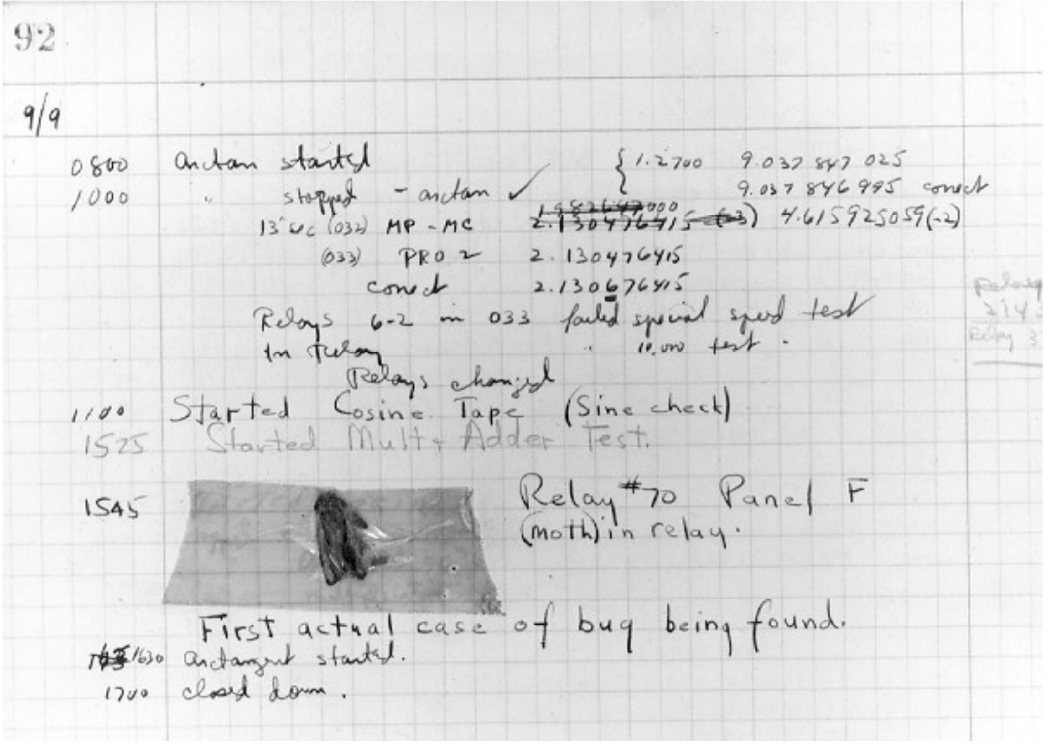
Debugging
1947

Slide 183
Debugging
The term bug dates back even earlier:
Hawkin’s New Catechism of Electricity, 1896
“The term ‘bug’ is used to a limited extent to designate any fault or trouble in the connections or working of electrical apparatus”

Slide 184
Runtime bugs
Overt vs Covert:
Overt has an obvious manifestation – code crashes or runs forever
Covert has no obvious manifestation – code returns a value, which may be incorrect but hard to determine
Persistent vs intermittent:
Persistent occurs every time code is run
Intermittent only occurs some times, even if run on same input

Slide 185
Categories of bugs
Overt and Persistent
obvious to detect
Overt and intermittent:
more frustrating, can be harder to debug, but if conditions that prompt bug can be reproduced, can be handled
Covert
highly dangerous, as users may not realize answers are incorrect until code has been run for long period

Slide 186
Debugging skills
Treat as a search problem: looking for explanation for incorrect behavior
study available data – both correct test cases and incorrect ones
Form an hypothesis consistent with the data
if I change line 403 from x<y to x<=y, the problem will go away
my program does not terminate because I have wrong exit condition
Design and run a repeatable experiment with potential to refute the hypothesis
Keep record of experiments performed: use narrow range of hypotheses

Slide 187
Debugging as search
Want to narrow down space of possible sources of error
Design experiments that expose intermediate stages of computation (use print statements)
Binary search can be powerful tool for this

Slide 188
Example
def isPal(x):
"""Assumes x is a list
Returns True if the list is a palindrome; False otherwise"""
temp = x
temp.reverse
if temp == x:
return True
else:
return False
def silly(n):
"""Assumes n is an int > 0
Gets n inputs from user
Prints 'Yes' if the sequence of inputs forms a palindrome;
'No' otherwise"""
for i in range(n):
result = []
elem = raw_input('Enter element: ')
result.append(elem)
if isPal(result):
print 'Yes'
else:
print 'No'

Slide 189
Debugging as search
Suppose we run this code
we try the input ‘a’ ‘b’ ‘c’ ‘b’ ‘a’, which succeeds
we try the input ‘p’ ‘a’ ‘l’ ‘I’ ‘n’ ‘n’ ‘I’ ‘l’ ‘a’ ‘p’, which succeeds
but we try the input ‘a’ ‘b’, which also succeeds
Let’s use binary search to isolate bugs
Pick a spot about halfway through code, and devise experiment
Pick a spot where easy to examine intermediate values

Slide 190
Example
def isPal(x):
"""Assumes x is a list
Returns True if the list is a palindrome; False otherwise"""
temp = x
temp.reverse
if temp == x:
return True
else:
return False
def silly(n):
"""Assumes n is an int > 0
Gets n inputs from user
Prints 'Yes' if the sequence of inputs forms a palindrome;
'No' otherwise"""
for i in range(n):
result = []
elem = raw_input('Enter element: ')
result.append(elem)
print result
if isPal(result):
print 'Yes'
else:
print 'No'

Slide 191
Stepping through the test
At this point in the code, we expect (for our test case of ‘a’ ‘b’), that result should be a list [‘a’, ‘b’]
we run the code, and get [‘b’]
Because of binary search, we know that at least one bug must be present earlier in the code
So we add a second print

Slide 192
Example
def isPal(x):
"""Assumes x is a list
Returns True if the list is a palindrome; False otherwise"""
temp = x
temp.reverse
if temp == x:
return True
else:
return False
def silly(n):
"""Assumes n is an int > 0
Gets n inputs from user
Prints 'Yes' if the sequence of inputs forms a palindrome;
'No' otherwise"""
for i in range(n):
result = []
elem = raw_input('Enter element: ')
result.append(elem)
print result
if isPal(result):
print 'Yes'
else:
print 'No'

Slide 193
Stepping through the test
When we run with our example, the print statement prints
[‘a’]
[‘b’]
This suggests that result is not keeping all elements
So let’s move the initialization of result outside the loop and retry

Slide 194
Example
def isPal(x):
"""Assumes x is a list
Returns True if the list is a palindrome; False otherwise"""
temp = x
temp.reverse
if temp == x:
return True
else:
return False
def silly(n):
"""Assumes n is an int > 0
Gets n inputs from user
Prints 'Yes' if the sequence of inputs forms a palindrome;
'No' otherwise"""
for i in range(n):
result = []
elem = raw_input('Enter element: ')
result.append(elem)
print result
if isPal(result):
print 'Yes'
else:
print 'No'
Bug here

Slide 195
Example
def isPal(x):
"""Assumes x is a list
Returns True if the list is a palindrome; False otherwise"""
temp = x
temp.reverse
if temp == x:
return True
else:
return False
def silly(n):
"""Assumes n is an int > 0
Gets n inputs from user
Prints 'Yes' if the sequence of inputs forms a palindrome;
'No' otherwise"""
result = []
for i in range(n):
elem = raw_input('Enter element: ')
result.append(elem)
print result
if isPal(result):
print 'Yes'
else:
print 'No'

Slide 196
Stepping through the test
So this now show we are getting the data structure result properly set up, but still have a bug somewhere
A reminder that there may be more than one problem
This suggests second bug must lie below print statement
Pick a point in the middle of the code, and add print statement again

Slide 197
Example
def isPal(x):
"""Assumes x is a list
Returns True if the list is a palindrome; False otherwise"""
temp = x
temp.reverse
print temp, x
if temp == x:
return True
else:
return False
def silly(n):
"""Assumes n is an int > 0
Gets n inputs from user
Prints 'Yes' if the sequence of inputs forms a palindrome;
'No' otherwise"""
result = []
for i in range(n):
elem = raw_input('Enter element: ')
result.append(elem)
if isPal(result):
print 'Yes'
else:
print 'No'

Slide 198
Stepping through the test
At this point in the code, we expect (for our example of ‘a’ ‘b’) that x should be [‘a’, ‘b’], but temp should be [‘b’, ‘a’]
However thy both have the value [‘a’, ‘b’]
So let’s add another print statement, earlier in the code

Slide 199
Example
def isPal(x):
"""Assumes x is a list
Returns True if the list is a palindrome; False otherwise"""
temp = x
print temp, x
temp.reverse
print temp, x
if temp == x:
return True
else:
return False
def silly(n):
"""Assumes n is an int > 0
Gets n inputs from user
Prints 'Yes' if the sequence of inputs forms a palindrome;
'No' otherwise"""
result = []
for i in range(n):
elem = raw_input('Enter element: ')
result.append(elem)
if isPal(result):
print 'Yes'
else:
print 'No'

Slide 200
Stepping through the test
And we see that temp has the same value before and after the call to reverse
If we look at our code, we realize we have committed a standard bug – we forgot to actually invoke the reverse method
need temp.reverse()

Slide 201
Example
def isPal(x):
"""Assumes x is a list
Returns True if the list is a palindrome; False otherwise"""
temp = x
print temp, x
temp.reverse()
print temp, x
if temp == x:
return True
else:
return False
def silly(n):
"""Assumes n is an int > 0
Gets n inputs from user
Prints 'Yes' if the sequence of inputs forms a palindrome;
'No' otherwise"""
result = []
for i in range(n):
elem = raw_input('Enter element: ')
result.append(elem)
if isPal(result):
print 'Yes'
else:
print 'No'

Slide 202
Stepping through the test
But now when we run on our simple example,
Both x and temp have been reversed
We have also narrowed down this bug to a single line. The error must be in the reverse step
In fact, we have an aliasing bug (side effect of mutability of list)
Reversing temp has also caused x to be reversed
Because they are referring to the same object

Slide 203
Example
def isPal(x):
"""Assumes x is a list
Returns True if the list is a palindrome; False otherwise"""
temp = x[:]
print temp, x
temp.reverse()
print temp, x
if temp == x:
return True
else:
return False
def silly(n):
"""Assumes n is an int > 0
Gets n inputs from user
Prints 'Yes' if the sequence of inputs forms a palindrome;
'No' otherwise"""
result = []
for i in range(n):
elem = raw_input('Enter element: ')
result.append(elem)
if isPal(result):
print 'Yes'
else:
print 'No'

Slide 204
Stepping through the test
And now running this shows that before the reverse step, the two variables have the same form
But afterwards only temp is reversed
We can now go back and check that our other test cases still work correctly

Slide 205
Some pragmatic hints
Look for the usual suspects, e.g. have you
passed arguments to a function in the wrong order
misspelled a name, e.g., typed a lowercase letter when you should have typed an uppercase cone
Failed to reinitialize a variable
tested that two floating point values are equal (==) instead of nearly equal (remember that float point arithmetic is not the same as the arithmetic you learned in school)
Tested for value equality (e.g., compared to lists by writing the expression L1==L2) when you meant object equality (e.g., id(L1) == id(L2))

Slide 206
Some pragmatic hints
Look for the usual suspects, e.g. have you
Forgotten that some built-in function has a side effect
Forgotten the () that turns a reference to an object of type function into a function invocation
created an unintentional alias
Made any other mistake that is typical for you

Slide 207
Some pragmatic hints
Look for the usual suspects
Ask why the code is doing what it is , not why is not doing what you want
The bug is probably not where you think it is
Sherlock Holmes said “Eliminate all other factors, and the one which remains must be the truth”
Explain the problem to someone else
Do not believe the documentation
Take a break and come back later

Slide 208
When you find “the” bug
Ask yourself if the bug explains all the observed symptoms
Or it is just the tip of the iceberg
Before making any change, try and understand the ramification of the proposed fix
Will it break something else?
Always make sure that you can get back to where you are

